Slide 1
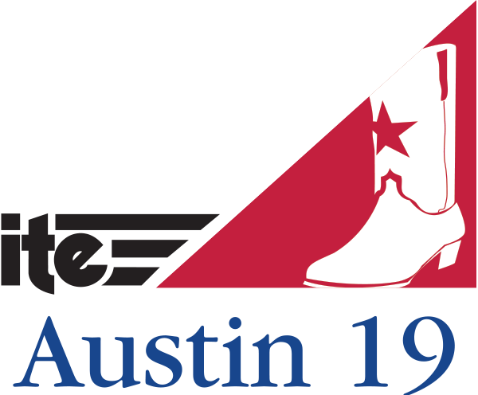

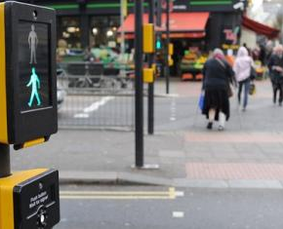

Improving pedestrian safety through its solutions
TRANSPORTATION TECHNOLOGY TOURNAMENT 2019
University of South Florida (Team 1)
Team Members: Rakesh Rangaswamy
Brian Staes
Divyamitra Mishra
Eren Yuksel
Nazmus Sakib
Guided By: Dr. Pei-Sung Lin
Dr. Nikhil Menon
Notes:
NOTE: Want a different image on this slide? Select the picture and delete it. Now click the Pictures icon in the placeholder to insert your own image.

Slide 2
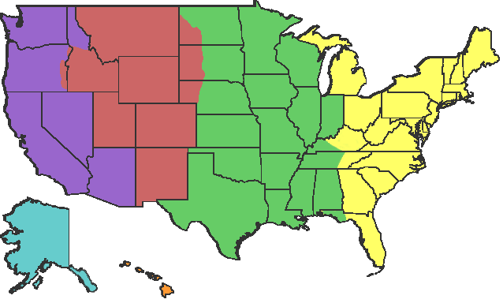
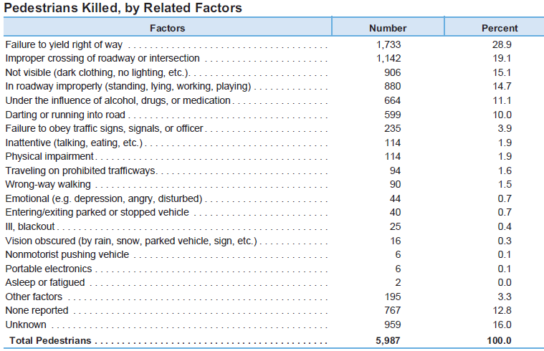

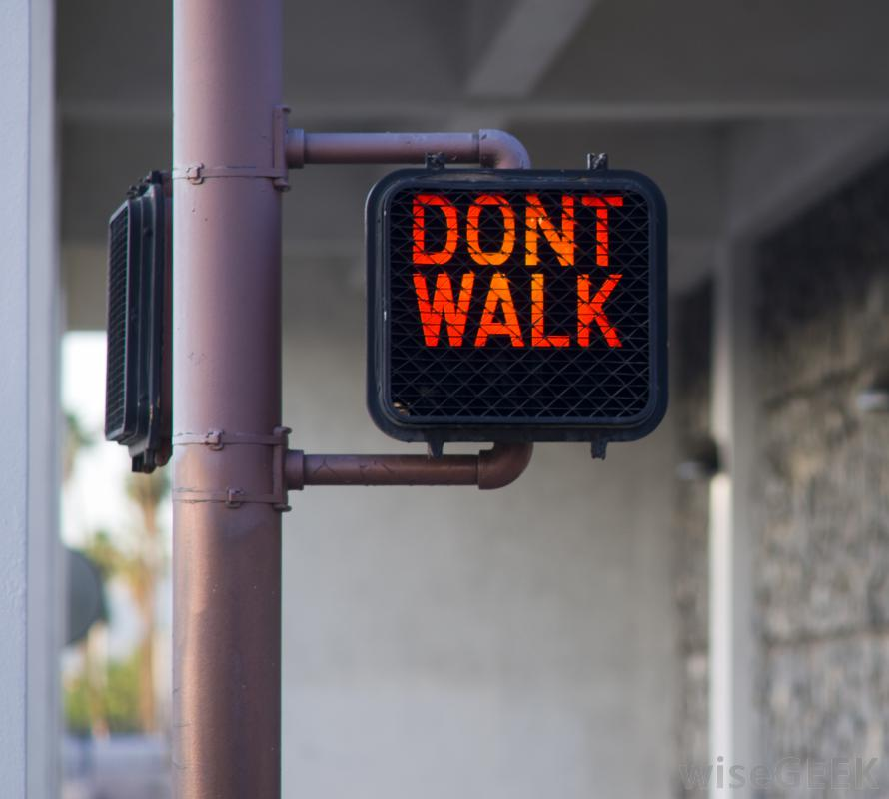
Background
U.S.A.
Florida
In 2017 crashes (9,420) and fatalities(659).
24% crossing the intersection when the pedestrian crossing signals were flashing red.
Ref: NHTSA Traffic Safety facts 2016

Slide 3
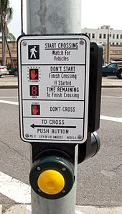
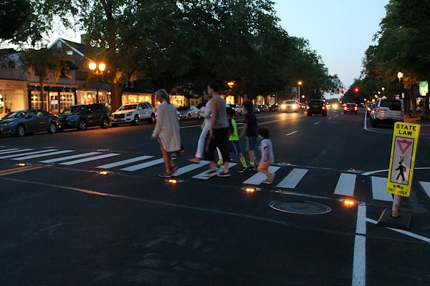

Motivation
40–50% of the pedestrians do not use push buttons
(or find them physically difficult to use) .
90 % decrease in the number of right turn on red violations
after installing the IPM system .
Providing pedestrian safety.

Slide 4
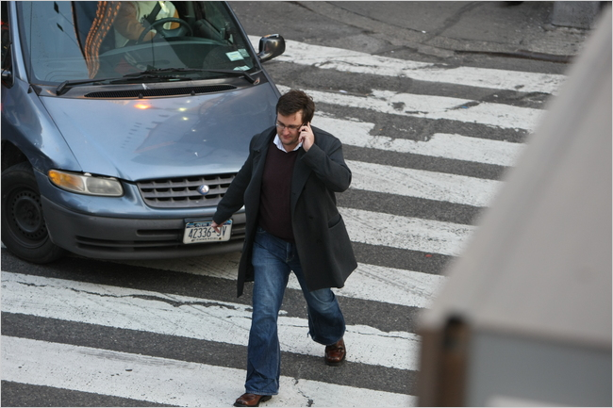
Problem Statement
Both pedestrians and drivers contribute to pedestrian crashes, injuries and fatalities at signalized intersection.

Slide 5
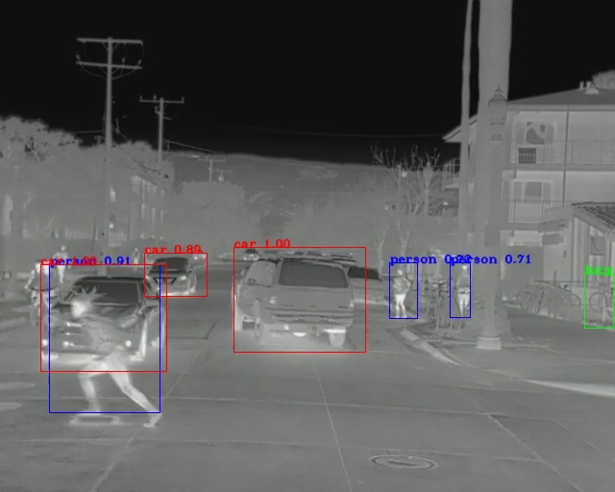
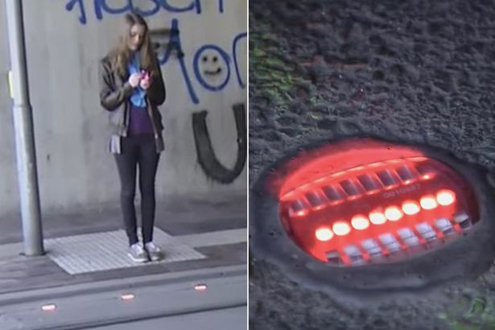
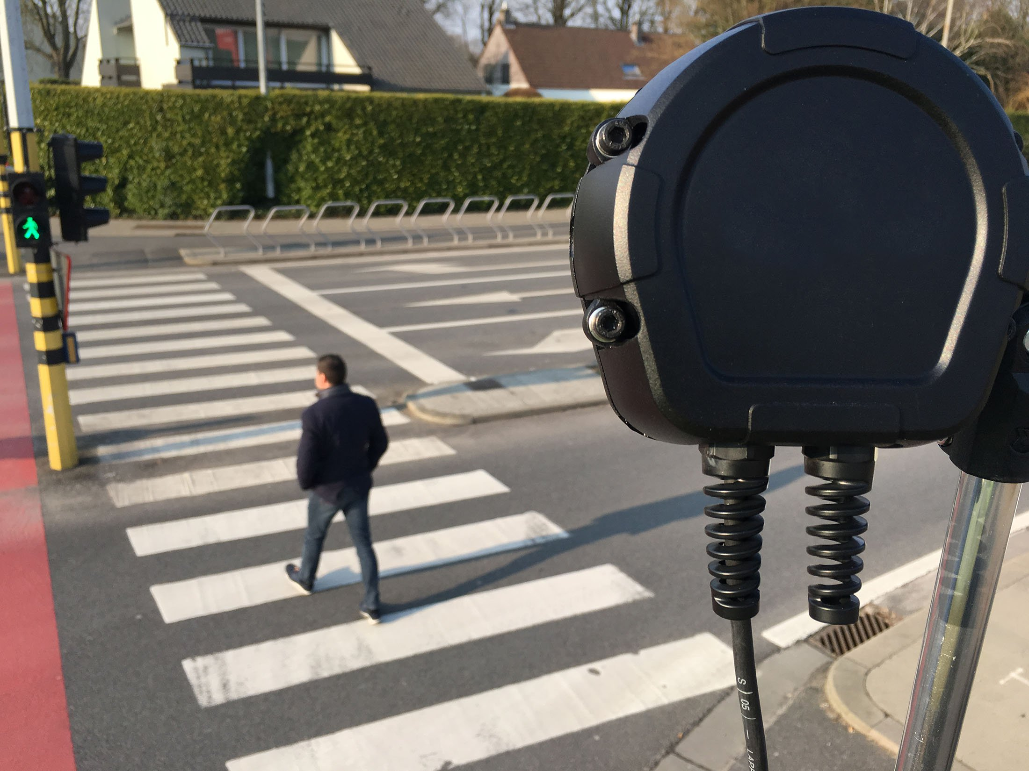
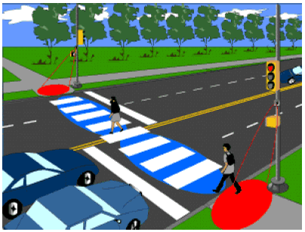
Proposed Solution
Use ITS and TSMO solutions to reduce pedestrian fatalities, crashes, and near-miss encounters at signalized intersections
Automated Pedestrian Detectors
Source: Flir Systems
Source: Mirror
+
Illuminated Pavement Markers (IPMs)
=
Safety
Source: Flir Systems
Source: FHWA.DOT.GOV

Slide 6



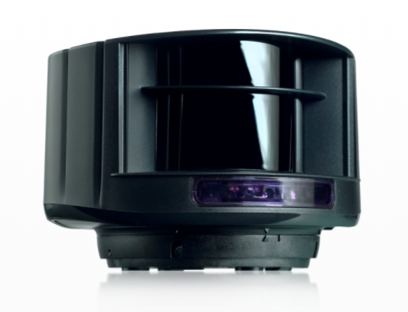
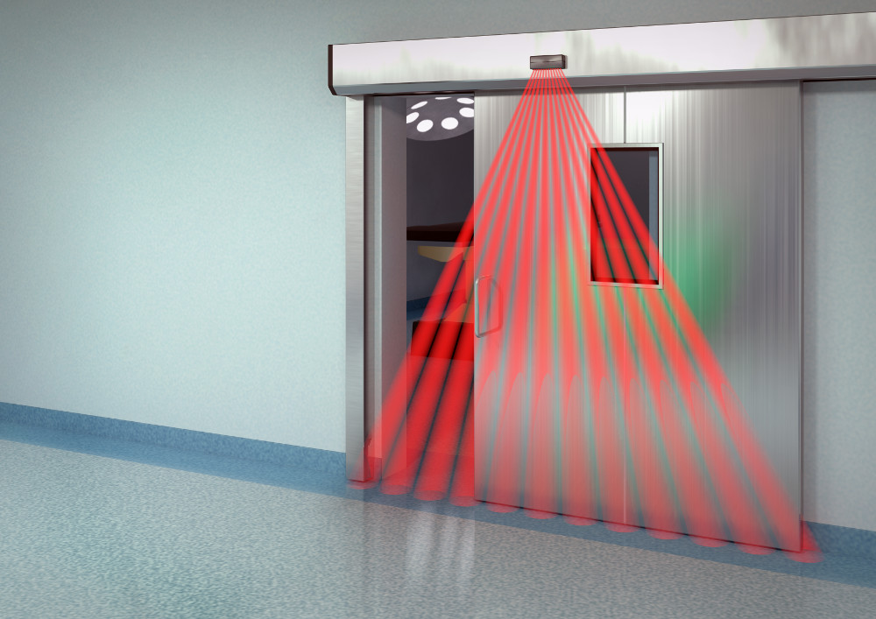
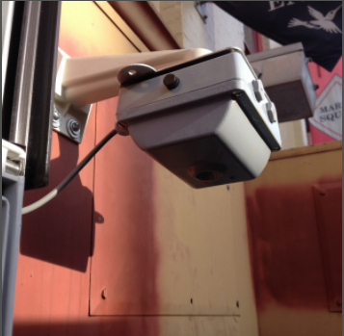
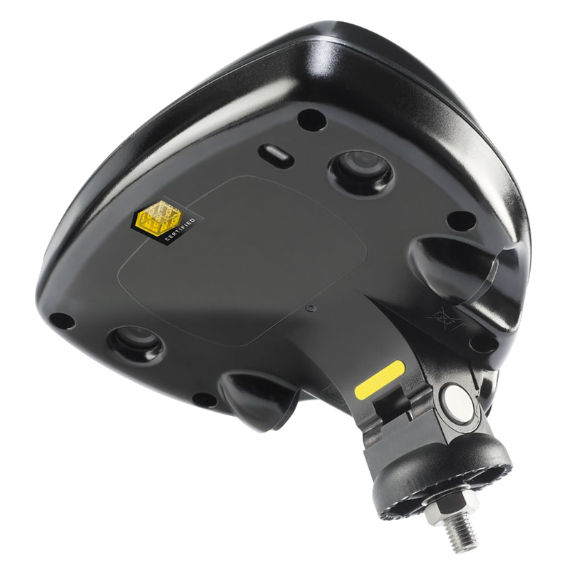
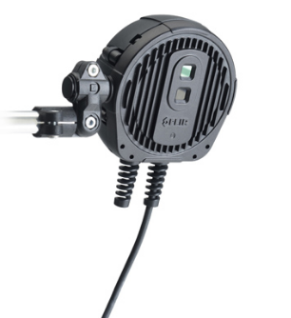
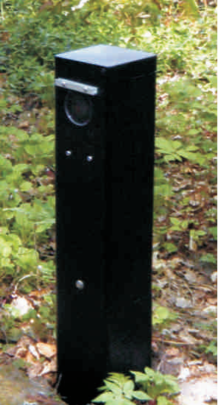
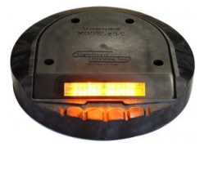
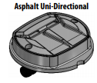
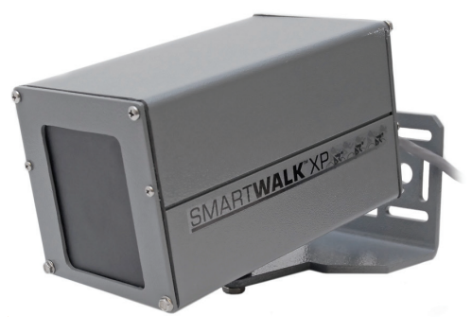
Existing and Emerging Technologies
Pros
Easy Installation
Data Verification
Automated process
Large coverage area
Portability
High accuracy
Low cost
Low maintenance
Low power consumption
Can distinguish pedestrian and bicycles
BEA LZR-I30 Laser Scanner
Active Infrared Sensor
CITIX-IR Passive Infrared Sensor
FLIR TrafiOne Thermal Imaging Sensor
Cons
Complex signal processing
Cannot detect accurately
Malfunctions after installation
Poor performance in sever weather condition
Different model setup applications
False trigger/ counts
Subsurface installation expensive
Gradual failure over years
Stereo Vision Pedestrian Detector
Radio Beam Sensors
Smartwalk XP Pedestrian Presence Sensor
LIGHTGUARD LGS-9X-1-4
MLK150 LaneLights
Notes:
Lanelight & Lightgaurd

Slide 7
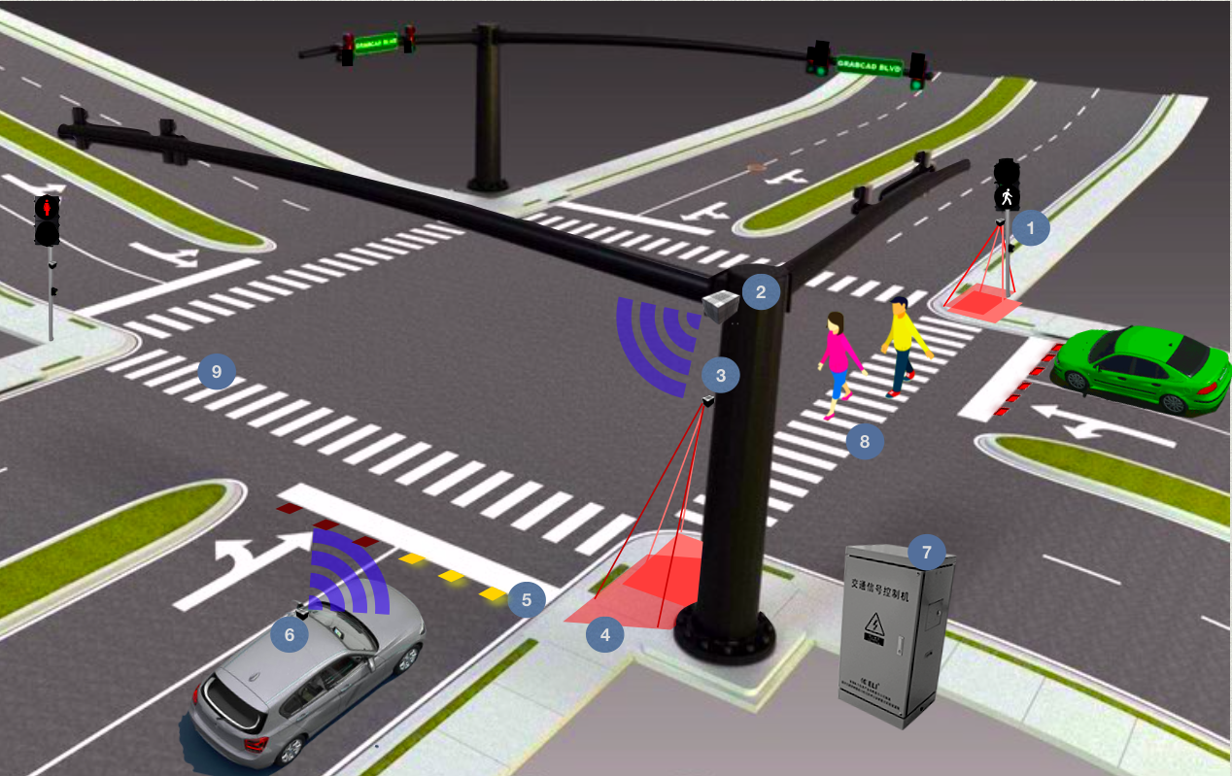
Proposed Solution
Physical Architecture of the Proposed Technology
[1 and 3] Automated pedestrian detectors physical locations
[2] Dedicated short range communication (DSRC) (discussed later)
[4] Pedestrian detection zone
[5] Internally illuminated in-pavement marker location
[6] Connected vehicle transmission to the DSRC (discussed later)
[7] Traffic control cabinet, housing the signal system controller and the IIIPM controller
[8] Cross-walk 1 and [9] Cross-walk 2
Notes:
MUTCD Chapter 4N.
Section 4N.01 Application of In-Roadway Lights
03 If used, In-Roadway Lights shall not exceed a height of 3/4 inch above the roadway surface.
04 When used, In-Roadway Lights shall be flashed and shall not be steadily illuminated.
**Steadily illuminated lights installed in the roadway surface are considered to be internally illuminated raised pavement markers (see Section 3B.11).**
MUTCD Chapter 3B.11
Section 3B.11 Raised Pavement Markers – General
The color of raised pavement markers under both daylight and nighttime conditions shall conform to the color of the marking for which they serve as a positioning guide, or for which they supplement or substitute.
02 The side of a raised pavement marker that is visible to traffic proceeding in the wrong direction may be red (see Section 3A.05).
Standard:
06 When used, internally illuminated raised pavement markers shall be steadily illuminated and shall not be flashed.

Slide 8
Scenario - 1

Slide 9
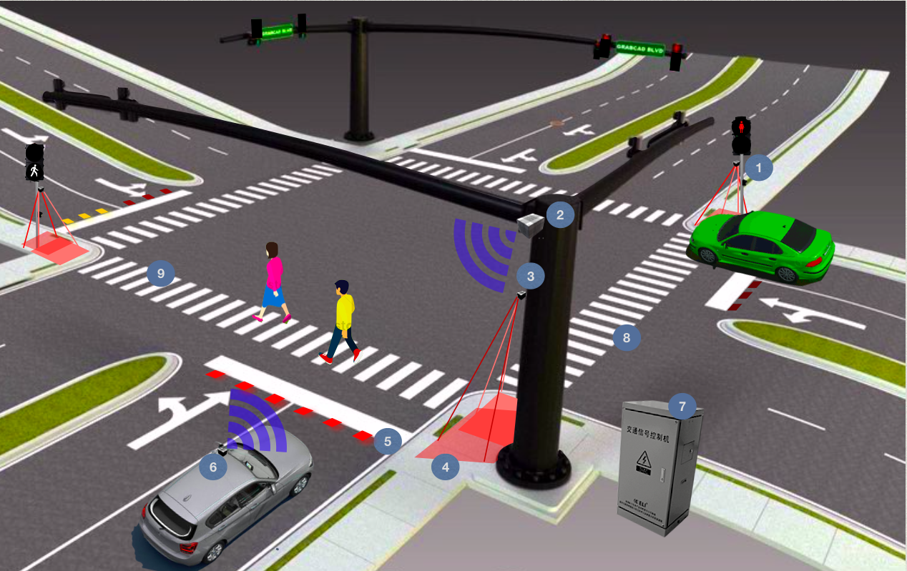
Scenario - 2

Slide 10
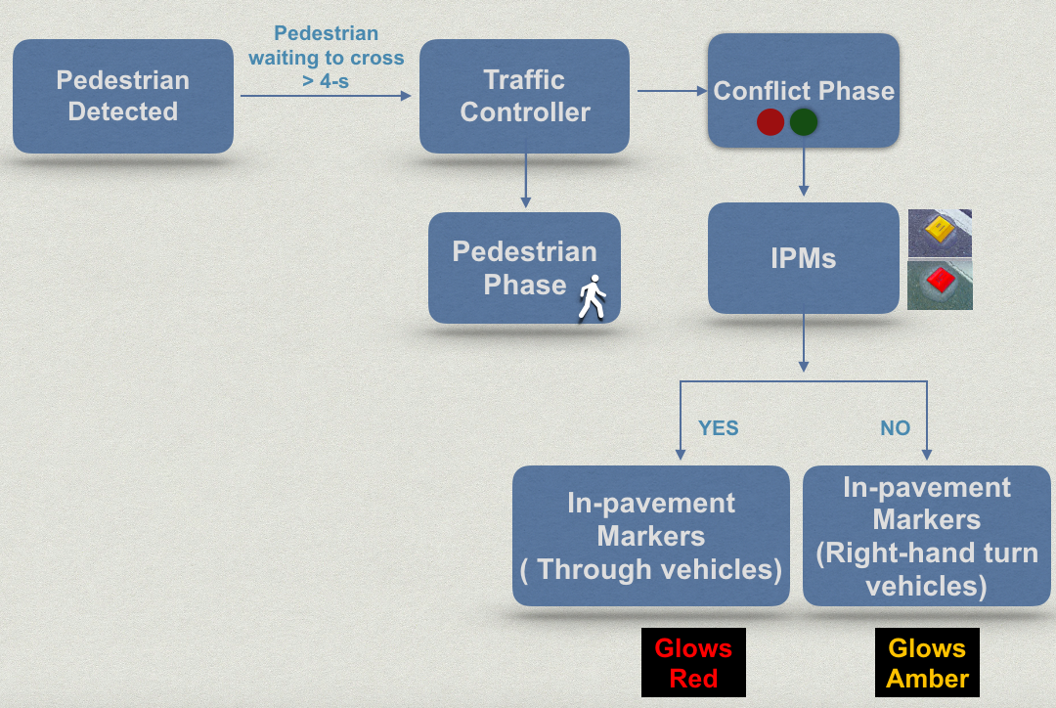
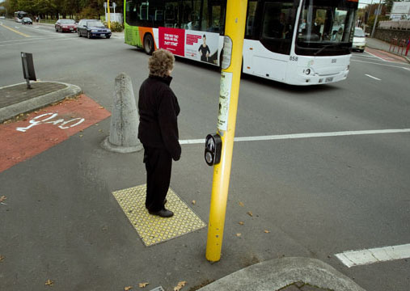
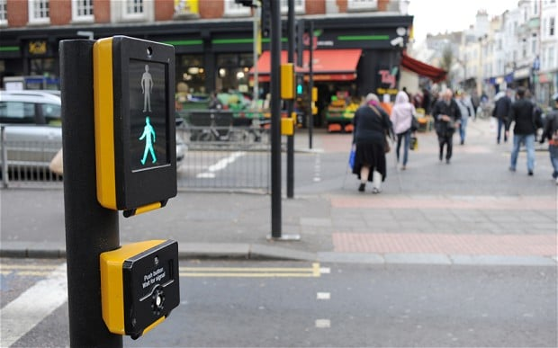
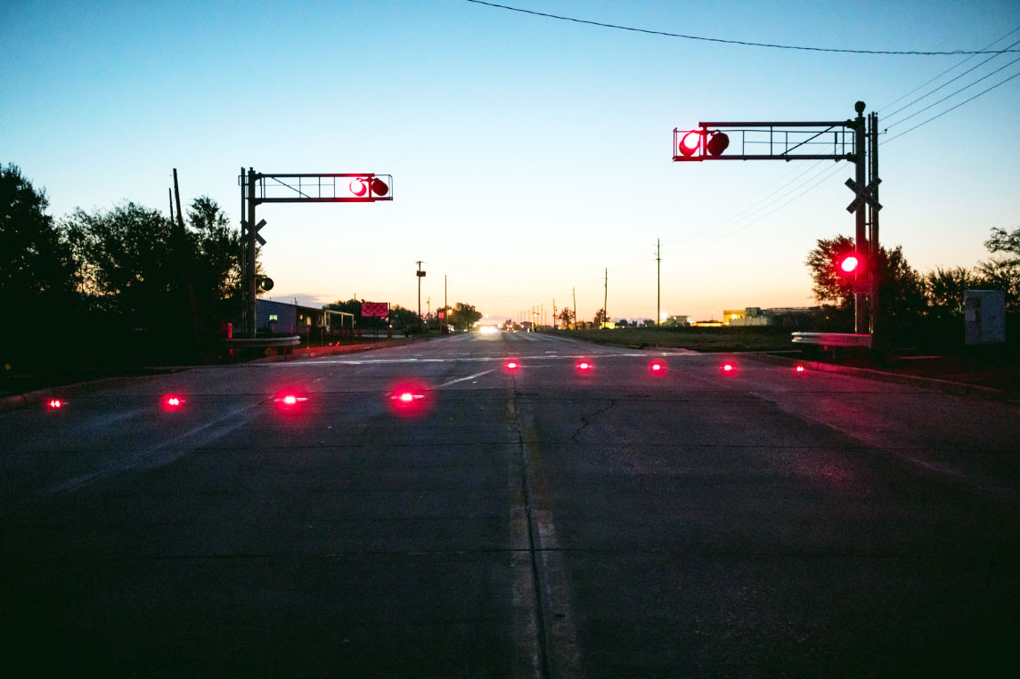
Proposed Solution
Functional Architecture of the Proposed Technology

Slide 11
Cost Estimation
Automated Pedestrian Detection Sensors
x4 Pedestrian Thermal Sensors
Fiber Optic & Electrical Service Cables
Material
x3 Bi-Colored IPM Per Lane
IPM System Controller
Labor
Internally Illuminated Bi-Colored In-Pavement Marker (IPM)
Road Closure
Notes:
LGS-9X-2 In-Roadway Warning Light: Bi-color: Red/Amber
630 2 12 $15.64 LF Conduit, F&I, Directional Bore : 100LF – 1564$ - This item is valid for signals, lighting, and other electrically powered or operated devices. MEASUREMENT- TRENCH or BORE: Measurement is for the straight line HORIZONTAL DISTANCE of the trench or bore, from pull box to pull box, with no allowance for sweeps or vertical distance. No additional payment will be made for multiple runs of conduit within a trench or bore.
665 1 11 $226.91 EA PEDESTRIAN DETECTOR, F&I, STANDARD : x4 - $900
633 11 21 $2.58 LF FIBER OPTIC CABLE, F&I, UG,2-12
411 1 $115.20 GA EPOXY MATERIAL- STRUCTURES REHAB
102 104 $10.52 ED TEMPORARY SIGNALIZATION AND MAINT, INTER -
DO NOT USE for Two-Way, Two-Lane Lane Closures Standard Plans 102-606 (Index 606); this item is for use at SIGNALIZED INTERSECTIONS.
Details
For existing intersections, the quantity to be paid for will be the number of signalized intersections (per each, per day) for the full duration of the Contract. For temporary intersections, the quantity to be paid for will be the number of signalized intersections per day for the duration of the temporary intersection. No separate payment will be made for temporary signalization and maintenance at new intersections. NOTE: Temporary intersections are locations away from existing or new intersections. Any pedestrian signals needed (existing, temporary or relocation) are included in this pay item.
102 1 $494.72 LS MAINTENANCE OF TRAFFIC - Includes all items required to safely maintain traffic throughout a transportation work zone with minimal inconvenience to the public and fit into one of the following categories: 1) cannot reasonably be quantified; 2) cannot be addressed under current pay items; 3) are incidental to the operations necessary to safely maintain traffic throughout a work zone. Code the second unit of measure (number of days) from the construction day estimate.
676 2500 $1,216.24 EA ITS CABINET- ADJUST/MODIFY -
639 21 $5.70 LF ELECTRICAL SERVICE WIRE, F&I

Slide 12
Cost Estimation
Automated Pedestrian Detection Sensors
In-Pavement Marker Installation
ITS Cabinet Modification
Material
Pedestrian Detector Installation
Labor
Internally Illuminated Bi-Colored In-Pavement Marker (IPM)
Road Closure
Notes:
LGS-9X-2 In-Roadway Warning Light: Bi-color: Red/Amber
630 2 12 $15.64 LF Conduit, F&I, Directional Bore : 100LF – 1564$ - This item is valid for signals, lighting, and other electrically powered or operated devices. MEASUREMENT- TRENCH or BORE: Measurement is for the straight line HORIZONTAL DISTANCE of the trench or bore, from pull box to pull box, with no allowance for sweeps or vertical distance. No additional payment will be made for multiple runs of conduit within a trench or bore.
665 1 11 $226.91 EA PEDESTRIAN DETECTOR, F&I, STANDARD : x4 - $900
633 11 21 $2.58 LF FIBER OPTIC CABLE, F&I, UG,2-12
411 1 $115.20 GA EPOXY MATERIAL- STRUCTURES REHAB
102 104 $10.52 ED TEMPORARY SIGNALIZATION AND MAINT, INTER -
DO NOT USE for Two-Way, Two-Lane Lane Closures Standard Plans 102-606 (Index 606); this item is for use at SIGNALIZED INTERSECTIONS.
Details
For existing intersections, the quantity to be paid for will be the number of signalized intersections (per each, per day) for the full duration of the Contract. For temporary intersections, the quantity to be paid for will be the number of signalized intersections per day for the duration of the temporary intersection. No separate payment will be made for temporary signalization and maintenance at new intersections. NOTE: Temporary intersections are locations away from existing or new intersections. Any pedestrian signals needed (existing, temporary or relocation) are included in this pay item.
102 1 $494.72 LS MAINTENANCE OF TRAFFIC - Includes all items required to safely maintain traffic throughout a transportation work zone with minimal inconvenience to the public and fit into one of the following categories: 1) cannot reasonably be quantified; 2) cannot be addressed under current pay items; 3) are incidental to the operations necessary to safely maintain traffic throughout a work zone. Code the second unit of measure (number of days) from the construction day estimate.
676 2500 $1,216.24 EA ITS CABINET- ADJUST/MODIFY -
639 21 $5.70 LF ELECTRICAL SERVICE WIRE, F&I

Slide 13
Cost Estimation
Automated Pedestrian Detection Sensors
Road User Cost
Maintenance of Traffic
Material
Labor
Internally Illuminated Bi-Colored In-Pavement Marker (IPM)
Road Closure
Notes:
LGS-9X-2 In-Roadway Warning Light: Bi-color: Red/Amber
630 2 12 $15.64 LF Conduit, F&I, Directional Bore : 100LF – 1564$ - This item is valid for signals, lighting, and other electrically powered or operated devices. MEASUREMENT- TRENCH or BORE: Measurement is for the straight line HORIZONTAL DISTANCE of the trench or bore, from pull box to pull box, with no allowance for sweeps or vertical distance. No additional payment will be made for multiple runs of conduit within a trench or bore.
665 1 11 $226.91 EA PEDESTRIAN DETECTOR, F&I, STANDARD : x4 - $900
633 11 21 $2.58 LF FIBER OPTIC CABLE, F&I, UG,2-12
411 1 $115.20 GA EPOXY MATERIAL- STRUCTURES REHAB
102 104 $10.52 ED TEMPORARY SIGNALIZATION AND MAINT, INTER -
DO NOT USE for Two-Way, Two-Lane Lane Closures Standard Plans 102-606 (Index 606); this item is for use at SIGNALIZED INTERSECTIONS.
Details
For existing intersections, the quantity to be paid for will be the number of signalized intersections (per each, per day) for the full duration of the Contract. For temporary intersections, the quantity to be paid for will be the number of signalized intersections per day for the duration of the temporary intersection. No separate payment will be made for temporary signalization and maintenance at new intersections. NOTE: Temporary intersections are locations away from existing or new intersections. Any pedestrian signals needed (existing, temporary or relocation) are included in this pay item.
102 1 $494.72 LS MAINTENANCE OF TRAFFIC - Includes all items required to safely maintain traffic throughout a transportation work zone with minimal inconvenience to the public and fit into one of the following categories: 1) cannot reasonably be quantified; 2) cannot be addressed under current pay items; 3) are incidental to the operations necessary to safely maintain traffic throughout a work zone. Code the second unit of measure (number of days) from the construction day estimate.
676 2500 $1,216.24 EA ITS CABINET- ADJUST/MODIFY -
639 21 $5.70 LF ELECTRICAL SERVICE WIRE, F&I
Road User Cost
detours and rerouting that add to travel time
reduced roadway capacity that slows travel speed and increases travel time;
• delay in the opening of a new or improved facility that prevents users from gaining travel time benefits

Slide 14
Cost Estimation
Procurement
Mobilization
Implementation
Estimated Timeline:
Automated Pedestrian Detection Sensors
Material
$27,000
Labor
$23,000
Internally Illuminated Bi-Colored In-Pavement Marker (IPM)
Road Closure
$26,000-$52,000
Estimated Total Cost:
$76,000-$102,000
2 to 4 Weeks
Notes:
LGS-9X-2 In-Roadway Warning Light: Bi-color: Red/Amber
630 2 12 $15.64 LF Conduit, F&I, Directional Bore : 100LF – 1564$ - This item is valid for signals, lighting, and other electrically powered or operated devices. MEASUREMENT- TRENCH or BORE: Measurement is for the straight line HORIZONTAL DISTANCE of the trench or bore, from pull box to pull box, with no allowance for sweeps or vertical distance. No additional payment will be made for multiple runs of conduit within a trench or bore.
665 1 11 $226.91 EA PEDESTRIAN DETECTOR, F&I, STANDARD : x4 - $900
633 11 21 $2.58 LF FIBER OPTIC CABLE, F&I, UG,2-12
411 1 $115.20 GA EPOXY MATERIAL- STRUCTURES REHAB
102 104 $10.52 ED TEMPORARY SIGNALIZATION AND MAINT, INTER -
DO NOT USE for Two-Way, Two-Lane Lane Closures Standard Plans 102-606 (Index 606); this item is for use at SIGNALIZED INTERSECTIONS.
Details
For existing intersections, the quantity to be paid for will be the number of signalized intersections (per each, per day) for the full duration of the Contract. For temporary intersections, the quantity to be paid for will be the number of signalized intersections per day for the duration of the temporary intersection. No separate payment will be made for temporary signalization and maintenance at new intersections. NOTE: Temporary intersections are locations away from existing or new intersections. Any pedestrian signals needed (existing, temporary or relocation) are included in this pay item.
102 1 $494.72 LS MAINTENANCE OF TRAFFIC - Includes all items required to safely maintain traffic throughout a transportation work zone with minimal inconvenience to the public and fit into one of the following categories: 1) cannot reasonably be quantified; 2) cannot be addressed under current pay items; 3) are incidental to the operations necessary to safely maintain traffic throughout a work zone. Code the second unit of measure (number of days) from the construction day estimate.
676 2500 $1,216.24 EA ITS CABINET- ADJUST/MODIFY -
639 21 $5.70 LF ELECTRICAL SERVICE WIRE, F&I
Road User Cost
“WORK ZONE ROAD USER COSTS CONCEPTS AND APPLICATIONS 2011 USDOT FHWA”
“TECHNIQUES FOR MANUALLY ESTIMATING ROAD USER COSTS ASSOCIATED WITH COSNTRUCTION PROJECTS”
GINGER DANIELS DAVID ELLIS
Travel Delay Cost Function of = AADT (1-%Truck)* AVG delay per vehicle
8$ per hour of delay per private vehicle
24$ per hour of delay
Assume 2 minutes of delay per hour
assume 12k aadt
Assume 10% Truck
=12k*(0.90)*(2/60) *8$ per hour of delay = $2880/Day
Trucks = $960/Day
Crash Cost
Work Zone Crash Rate
Personal injury Crash Rate
CR = A*10^6/T*L*AADT*365
A = Average number of crashes along roadway segment during analysis period
T = Duraction of analysis in years
L length of segment in miles
Emissions Costs (Vehicle Operating Cost)
detours and rerouting that add to travel time
reduced roadway capacity that slows travel speed and increases travel time;
• delay in the opening of a new or improved facility that prevents users from gaining travel time benefits
Maintenance of Traffic Alternative Analysis

Slide 15
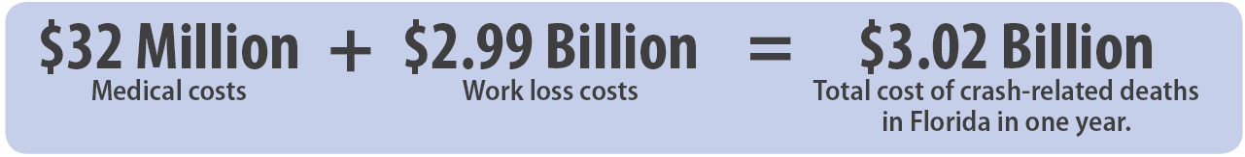
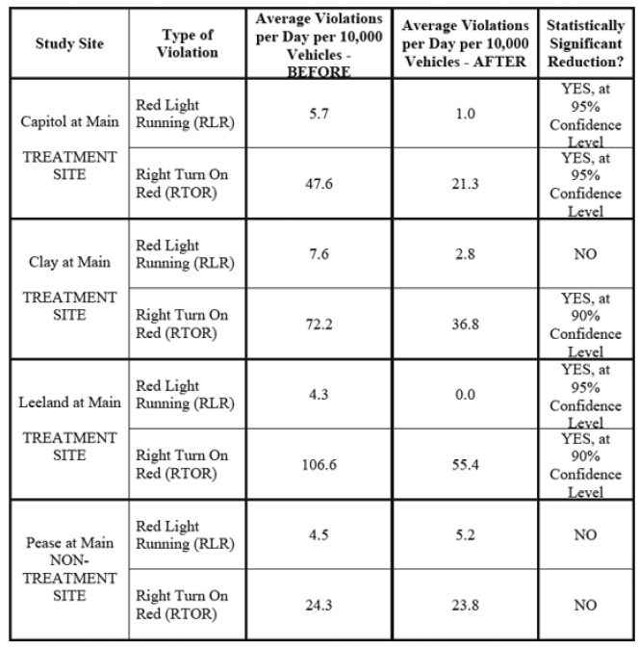
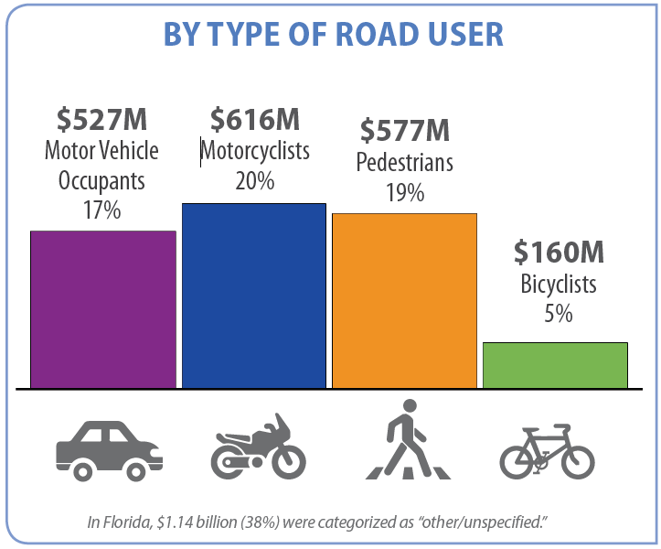
Economic Impact
Source: National Center for Injury Prevention and Control
FLORIDA
“Evaluation of Lighted Pavement Marker Stop bars ….” Johnathan Tydlacka TTI , Case study in Texas…
TEXAS

Slide 16
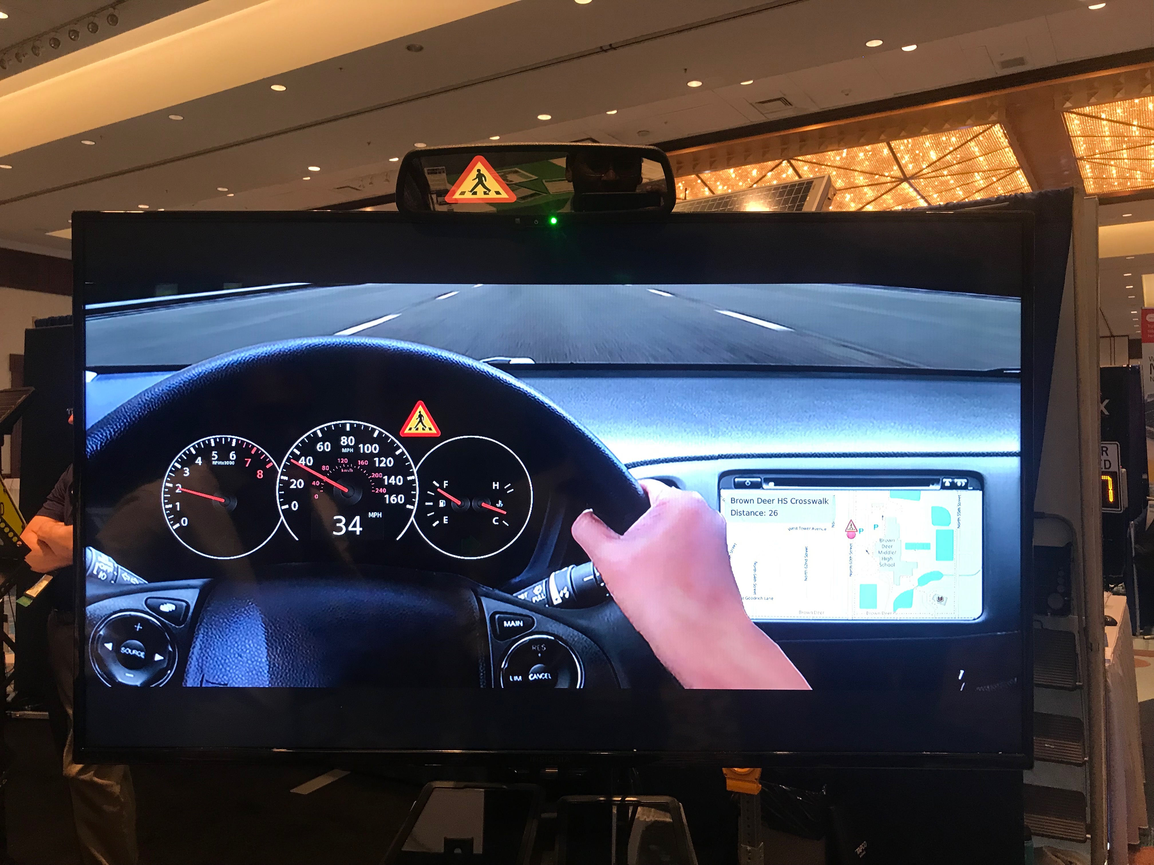
Future Work
Dedicated Short Range Communications (DSRC)
and/or
5G Connection
Automated Pedestrian
Detection
Traffic Signal
Controller
DSRC/5G
Visual/Audio warning in Connected Vehicle
In-pavement markers activated
Future Connected Vehicle Framework

Slide 17
Conclusion
Driver’s failure to yield to pedestrians at signalized intersection/ react on time is a major problem
Our proposed solution is to use Automated pedestrian detection system + IPM - Decrease pedestrian-motor vehicle incidents
Easy installation - Automated pedestrian detection system + IIPM - wider area ( extending beyond places with high crash rates).
Advantages - limited environmental impact
- devices are strong and easy to produce
- large benefits cost ratio (at severe pedestrian crash locations)
- parts can be recycled for new systems
Implementation of our proposed idea can reduce pedestrian crashes at signalized intersection.

Slide 18
References
Smart Growth America. Dangerous By Design 2019. https://smartgrowthamerica.org/dangerousby-design/
Florida DOT. Florida Strategic Highway Safety Plan, 2016. https:// fdotwww.blob.core.windows.net/sitefinity/docs/default-source/safety/safety/shsp2016/ fdot_2016shsp_final.pdf?sfvrsn=3c118f35_0
The Florida Department of Highway Safety and Motor Vehicles (DHSWV) Traffic Crash Facts Annual Report 2017. https://firesportal.com/Pages/Public/DHSMVDocuments.aspx
National Highway Traffic Safety Administration (NHTSA). Traffic Safety Facts 2016 Data. DOT HS 812 493.
National Cooperative Highway Research Program (NCHRP S-380). “Applications of Illuminated, Active, In-Pavement Marker Systems.” NCHRP Synthesis 380. https://www.lightguardsystems.com/wp-content/uploads/2013/02/NCRH-ApplicationsOfIlluminatedActiveIPMSystems1.pdf
Wage Determinations OnLine.gov (WDOL) “Selecting DBA Wage Decisions”. https://www.wdol.gov/dba.aspx
Nambisan, S. S., Pulugurtha, S. S., & Karkee, G. (2006). An evaluation of the effectiveness of an inpavement flashing light system. In Transportation Research Board 85th Annual Meeting (No. 06- 1972).
Hofer, J. Yim, L. (2018). Experiment 8(09)-8 (E). Los Angeles Metro. http://www.dot.ca.gov/trafficops/ctcdc/docs/Final-Report-IIRPM-Los-Angeles-091018.pdf
Baker, T. (2002). National Electrical Code Requirements for In-Roadway Lights. IMSA Article Form. IMSA Journal Article Aug 2002.
Hamood, F., Parentela, E.M., Mustafa, Z., Killian, C. (2015). In-Road Warning Lights: Revisiting Pedestrian Crosswalk Application. https://www.westernite.org/annualmeetings/15_Las_Vegas/Papers/5A-Killian.pdf
Tydlacka, J. (2010). Evaluation of Lighted Pavement Marker Stop Bard and LED Outline Trarffic Signal Backplates. Texas Transportation Institute. IMSA Journal.
Liu, Y., Dion, F., & Biswas, S. (2005). Dedicated short-range wireless communications for intelligent transportation system applications: State of the art. Transportation research record, 1910(1), 29-37.

Slide 19

THANK YOU!

