Slide 1
How Can Modular Vehicles Bring Flexible Capacity to Transit Systems?
A Case of Pinellas County, FL
Xiaowei Shi, Mingyang Pei, Zhiwei Chen, Monis Wazir
Civil & Environmental Engineering
University of South Florida (USF)
Advisor: Xiaopeng Li, Pei-Sung Lin
Notes:
Hello everyone, please let me represent my group to make this presentation. Our project names …….

Slide 2
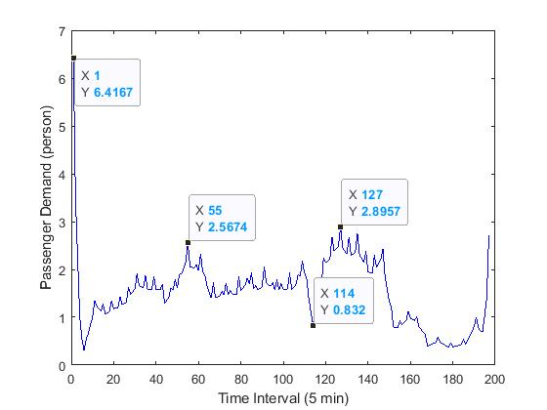
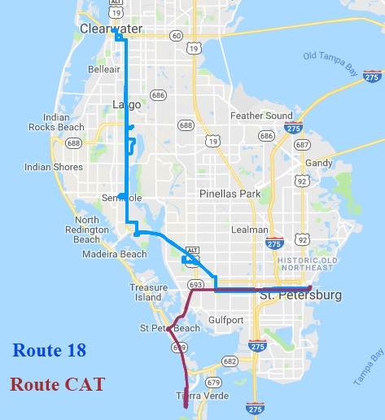

Background
Asymmetric passenger demand across different periods in a day and different geographic locations
Overlapping routes
Data is from Pinellas Suncoast Transit Authority (PSTA), the public transit provider for Pinellas County, Florida
Notes:
Firstly, let me introduce the background of our project.
As many transit operators across the world, the public transit provider for Pinellas County, Florida, is facing the problem that the passenger demand is asymmetrically distributed across different periods in a day and different geographic locations. While the high passenger demand in one area, the operation routes for different line inevitably are overlapped.
In this study, we use route 18 and route CAT of PSTA, the public transit provider for Pinellas County, as an instance to investigate the asymmetric passenger demand problem.

Slide 3
Existing Solution
    A few types of fixed headway based on the fluctuating passenger demand.
Route 18 |  | Route CAT
Period | Dispatch Headway | Period | Dispatch Headway
5:25-9:00 | 20min | 6:00-19:00 | 20min
9:00-15:00 | 30min | 19:00-22:00 | 30min
15:00-19:00 | 20min
19:00-22:00 | 60min
    Much energy is spent on moving the empty vehicles rather than transporting passengers. Up to 80% of the total energy is wasted.
Reference: JIAN, L., 2017. Available Measures to Energy Savings in Urban Rail Transit Operations. Shenzhen Subway
Notes:
To solve this problem, the existing solution is dispatch vehicles with a few types of
As you can see in the table, during a whole day’s operation, Route 18 has
Can relieve the problem. But In this situation, much energy is spent on moving the empty vehicles rather than transporting passengers, which can account for up to 80% of the total energy consumption in some systems

Slide 4
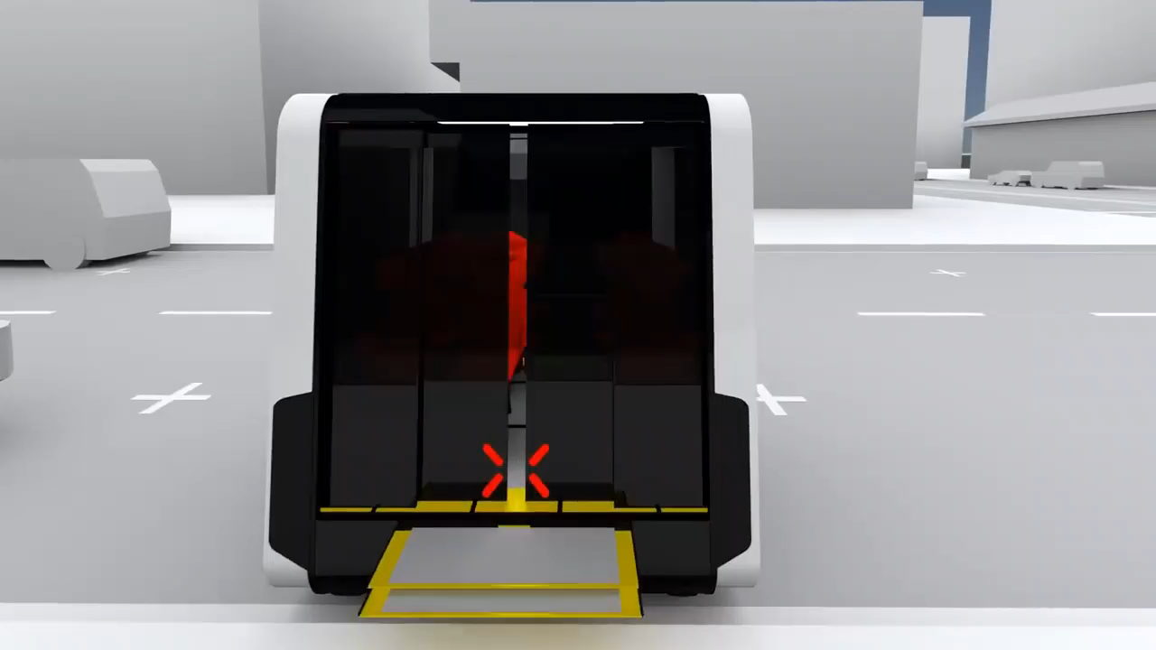
Emerging Technologies: Modular Vehicles
    The emerging technologies, modular vehicles, offer us a new perspective to solve the supply-demand mismatch problem.
(source: http://www.next-future-mobility.com/)
    Vehicles are composed of identical units.
    Vehicles and units can be concatenated or detached during operations or at stations.
Notes:
Thanks for the emerging technologies.
Some of you guys may not know this concept very clearly, so next we will have a small video to help you understand it.
Based on this video, we can know the characteristics of the MV.
With this technology, less units in vehicles with sparse demand at stations and vice verse.

Slide 5


Proposed solution illustration
Step 1:
For this specific demand scenario， dispatch a vehicle with 5 units at the origin station.
Step 2:
At intersection station, this vehicle is detached to two vehicles.
Vehicle 1 with 3 units go to Route 18 direction.
Vehicle 2 with 2 units go to Route CAT direction.
Notes:
Then we propose a solution to the asymmetric passenger demand problem based on this concept.
To clearly understand the proposed operation process, we still use Route 18 and Route CAT as an instance. But what must be mentioned is the proposed solution is not just suitable for this specific scenario.
Assume the passenger demand is as shown in the figure, to satisfy all the demand, dispatch 5 units at the O.
This vehicle will operate as a normal transit vehicle until it reaches the intersection station.

Slide 6
Proposed solution illustration
Step 3:
Each vehicle operates individually until reaches its own terminal station and then backs to the intersection station.
Step 4:
Two vehicle are concatenated at intersection station.
Step 5:
The new formed vehicle backs to the origin station.

Slide 7

Operation Process
Notes:
To accomplish this operation, four essential parts in the system need to collaborate with each other.
First one is database, store the history and real-time demand data and real-time schedule info data. Get data from and pass data to

Slide 8
Ticket Booking System
Request Service
Boarding Guidance
Notes:
A demonstration for the ticket booking system, passengers can make reservations either via PSTA APP or ticket machine at the stop.
Once the system receives the service request information, the system will pass the boarding guidance to the passenger.

Slide 9
Methodology Support
Method: Optimization
Purpose: Obtain an optimal schedule with minimizing the total system cost.
Objective Function:
$$\min_{y,xu,xl,u,c,b,z}{w\sum_{i∈ℐ,j>i∈ℐ,t^{′}≤t∈𝒯,t∈𝒯}{\left.δb_{ijt^{′}t}(t−t^{′}\right)}+\sum_{l∈ℒ,t∈𝒯}{y_{lt}e_{l}}}$$
Passenger waiting time cost
Vehicle dispatch cost
Notes:
With all the operation process we introduced above, here we will briefly introduce the methodololy behind the proposed method. That is How we generate the optimal schedule for the system. We use operation method to obtain

Slide 10
Experimental Result
    Compared with the general operation mode, the proposed mode:
    Dispatch 11.68% more units.
    Passenger average waiting time decreases to 40.20%.
    Total cost decreases to 74.19%.
 | Served Pass. | AWT (min) | TWT (min) | WTC ($)
Line 18 | 3193 | 7.66 | 24460.67 | 6930.52
Line CAT | 3433 | 7.42 | 25485.21 | 7220.81
Proposed Mode | 6627 | 3.03 | 20080.20 | 5689.36
 | Disp. Units | Vehicle Disp. Cost ($) | Total Cost ($)
Line 18 | 32 | 2304 | 9234.52
Line CAT | 45 | 1620 | 8840.81
Proposed Mode | 86 | 7722 | 13411.39
Passenger waiting time cost of proposed mode
Total cost of proposed mode
+
Passenger waiting time cost of original
+
Total cost of original
Notes:
By input the relevant operation parameter, e.g. passenger demand, headway and operation cost, we compare the proposed method with the gereral operation. Dark is the proposed. The whole is original.

Slide 11
Work Estimate
 | Cost Estimation | Time Estimation
Task 1: Optimization models
a. Historical data collection | Data is provided by the PSTA; Model and algorithm are studies by our team. | 2 weeks
b. Model and algorithm design |  | 1 month
c. Test model and algorithm with data |  | 1 week
Task 2: Smartphone APP
a. Design and code APP | The cost for designing and coding an APP is about $50k, testing the APP is about $20-30k (https://www.formotus.com). | 1 month
b. Test and revision |  | 1 month
Notes:
Based on the priority and workload of each task, we divide the whole work into 5 tasks.

Slide 12
Work Estimate
 | Cost Estimation | Time Estimation
Task 3: Database
a. Data-base design | The cost for designing and constructing a database is about $10k - $500k (http://www.costowl.com) | 1 month
b. Database construction |  | 1 month
Task 4: Vehicle procurement
Vehicle procurement | Based on the fleet size, the cost for vehicle can be calculated by $250,000*N [1], where N is the number of vehicles. | 1 month
Task 5: Operational plan adjustment
a. Crew scheduling | 6.94(Millions) [1] | 1 week
b. Fleet management | 27.40(Millions) [1] | 1 week
[1] American Public Transportation Association Page23

Slide 13
Summary and future enhancement
    Propose a high-level design of an innovative modular vehicle-based shared-corridor transit system to solve the demand-supply mismatch problem for two routes in the PSTA system.
    Future works can focus on some customized algorithms to further improve the solution efficiency.
Notes:
As you can see, the proposed method works better with the fluctuating passenger demand. Therefore, it can be applied to not only the PSTA system, FL, but also some transit systems from other cities. Like Washington DC, New York this kind of big cities.

Slide 14

Thank you

