Slide 1
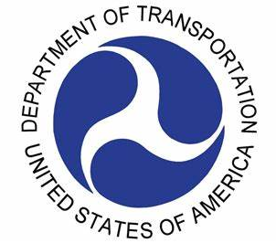
TSM&O Solutions to Mitigate Wrong-Way Driving (WWD) Crashes on Arterials
2019 NOCoE TRANSPORTATION TECHNOLOGY TOURNAMENT
ITS - PCB

Slide 2
Presentation Overview
Background
Study Corridors
Proposed Solutions
ITS Architecture
Deployment Costs and Timeline
Expected Benefits

Slide 3
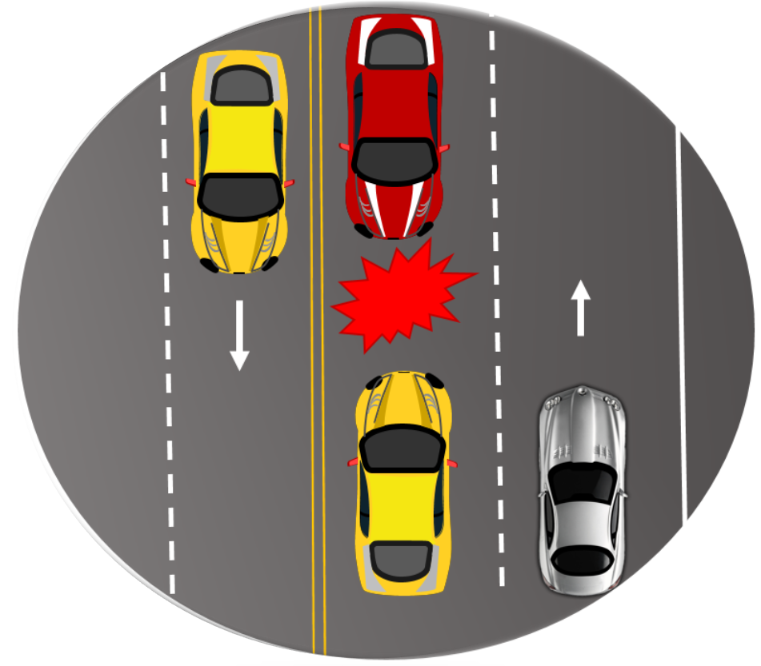
WWD Crashes
Wrong-way Driving (WWD) is the movement of vehicle in direction opposite to the one designated for travel
Proportion
Type
3% crashes
on high
speed divided
highways
Head-on and opposite
direction sideswipes
Attributes of
WWD crashes
Frequency
Severity
350 fatalities
annually nationwide
Incapacitating
injuries and
fatalities

Slide 4
WWD Crashes on Arterials
Arterials are 2.3 times more likely to experience WWD incidents than freeways
Mitigating WWD incidents on arterials is more complicated as they have several access points
Frequency
Location
1,890 crashes on arterials
(2012-2016)
> 50% of crashes intersection-related
Florida Statistics
Streets
Time
13.5% crashes on one-way streets
> 64% of all fatal crashes at night

Slide 5
Objectives
1
To assess the existing conditions on arterials that experienced frequent WWD crashes and incidents
2
To propose TSM&O solutions to mitigate WWD incidents on arterials
Traditional Solutions
TSM&O Solutions

Slide 6
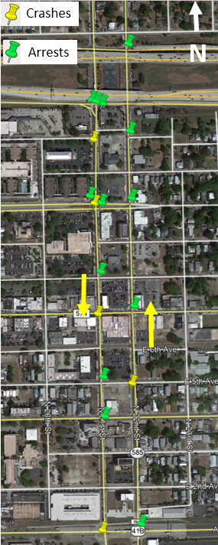
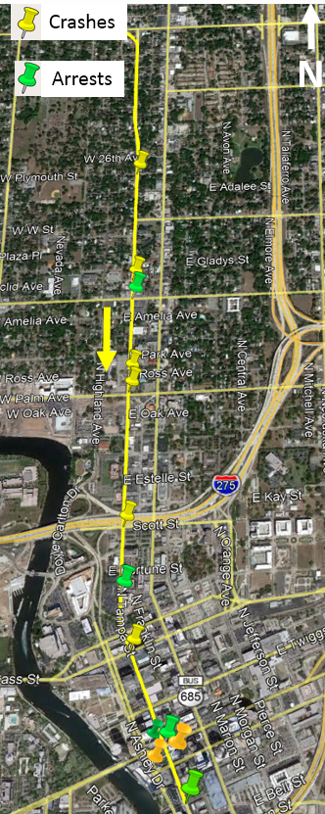
Study Corridors
N 22nd St & N 21st St
1-mile, one-way pair of parallel segments
7 Stop signs and 7 signals
5 WWD crashes 2012-2015
13 WWD arrests 2015-2019
N Tampa St
2.7-mile section, one-way three-lanes
23 Stop Signs and 14 signals
8 WWD crashes 2012-2015
6 WWD arrests 2015-2019

Slide 7
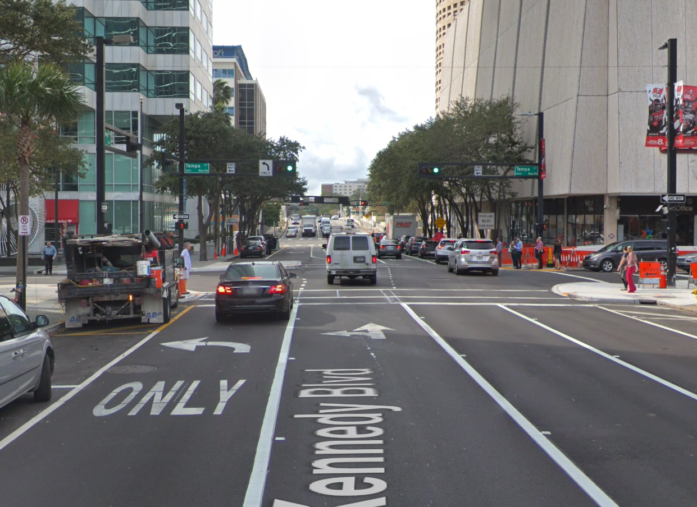
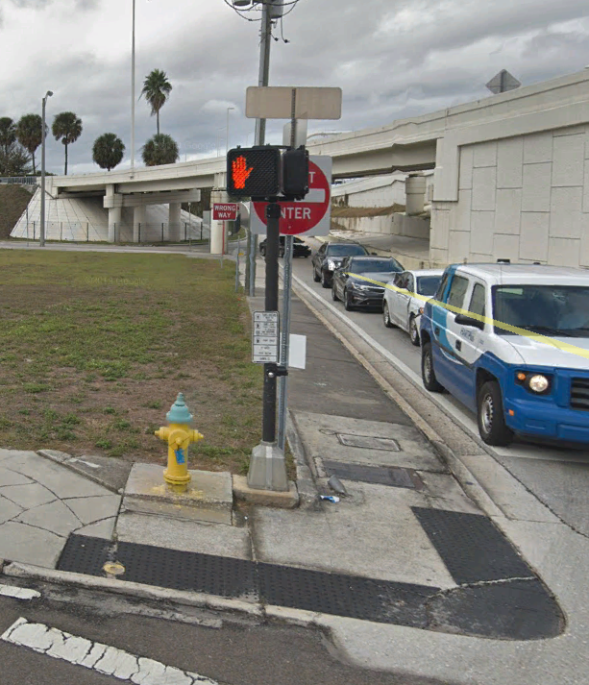
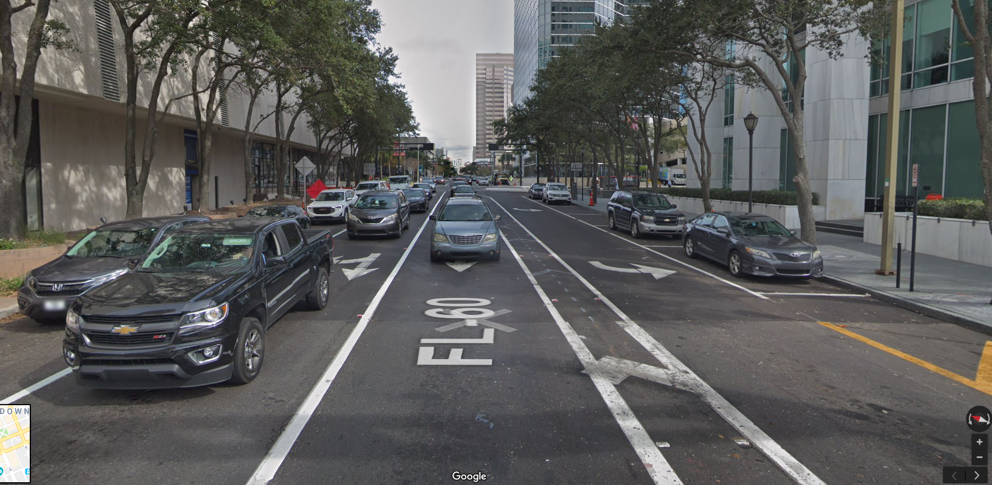
Existing Conditions
What the Right-Way Drivers see
1
Small and scattered
signs
2
Poor
lighting
Obstructed
WWD Signs
6
Problems?
3
WW signs
Not easily seen
No WW signs along the corridor
What the Wrong-Way Drivers see
Inconsistent
WW signage
5
4

Slide 8
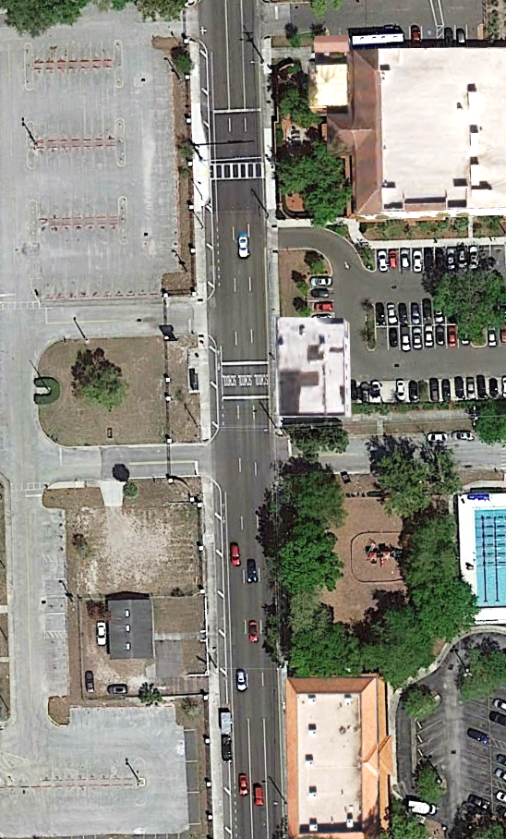
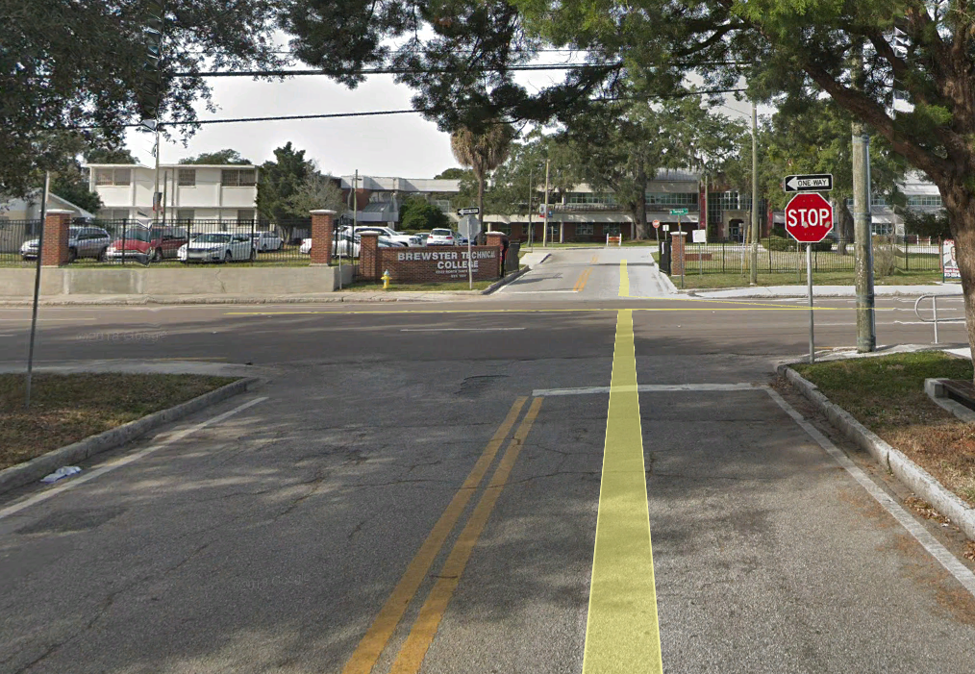
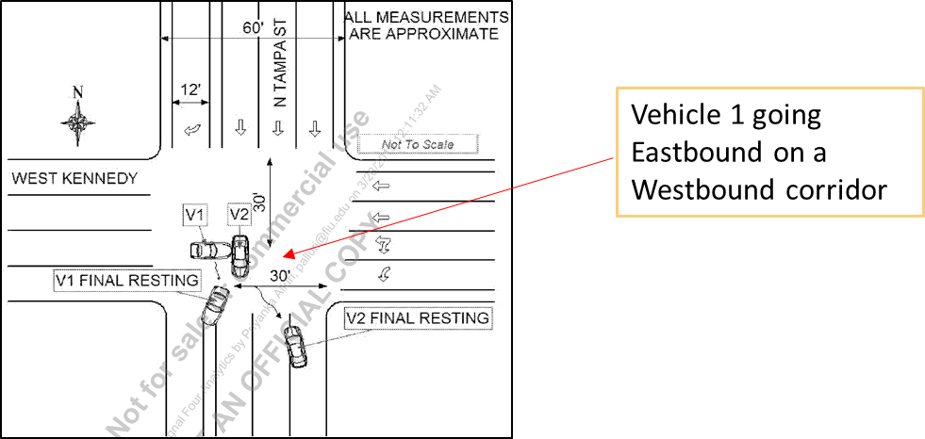
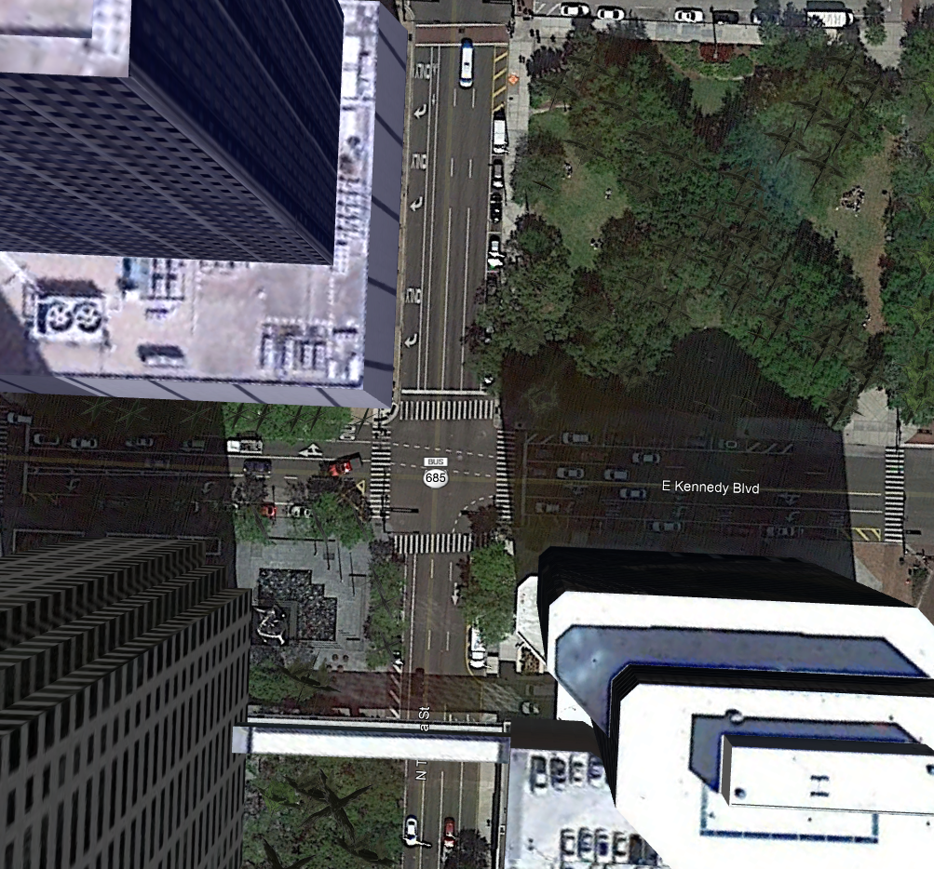
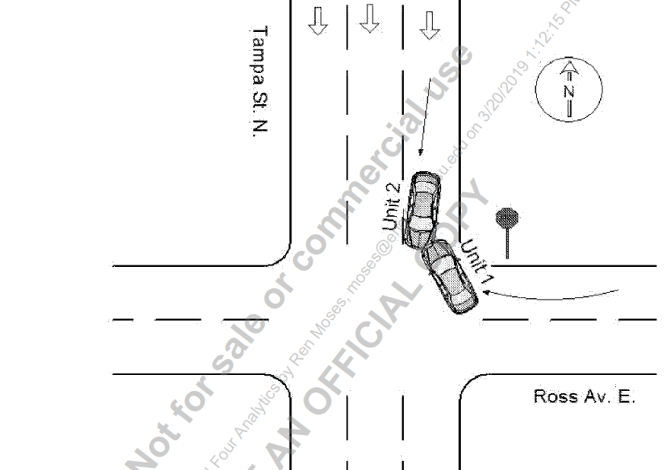
Critical Locations with WWD Crashes
N
Vehicle 1 going eastbound on a westbound corridor
Vehicle 1 turning right to the wrong direction
N

Slide 9
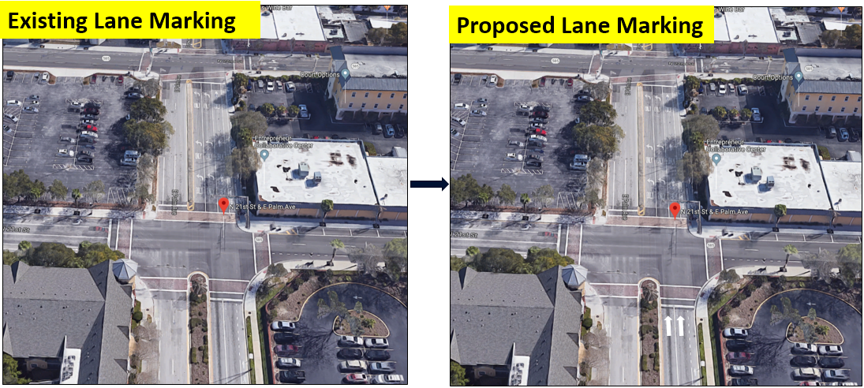
Proposed Solutions
Quick Fixes
Enhancement to Traditional Signs
Innovative TSM&O
Solution
Enhancement to Existing Signs
Adding Directional Pavement Markings to Avoid Wrong Way Left Turns

Slide 10
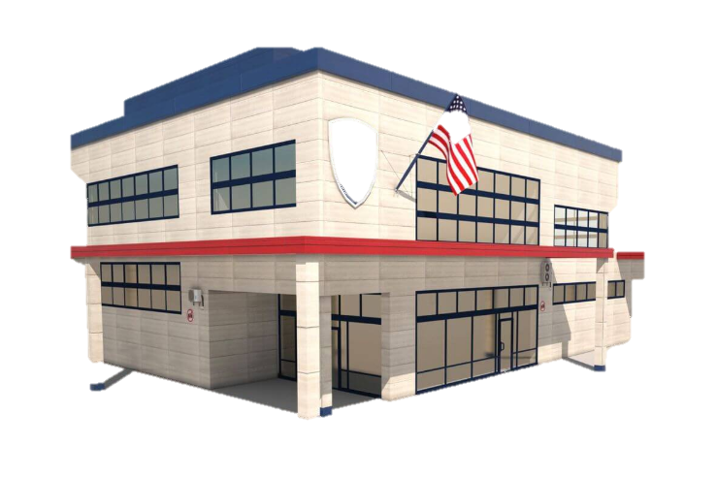
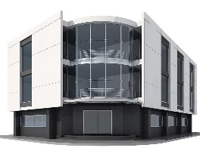
E Jackson St.
E Kennedy Blvd.
Notification
E Madison St.
Thermal Imaging Detection Cameras sending message to the Signal Controller
Notification
Detection-triggered “WRONG WAY” signs with LED Lights
N Tampa St.
LED-lit “NO LEFT/RIGHT TURN & ONE WAY Signs
Detected WW Driver
Flashing Red Signal activated after Detecting a WWD
IIRPMs

Slide 11
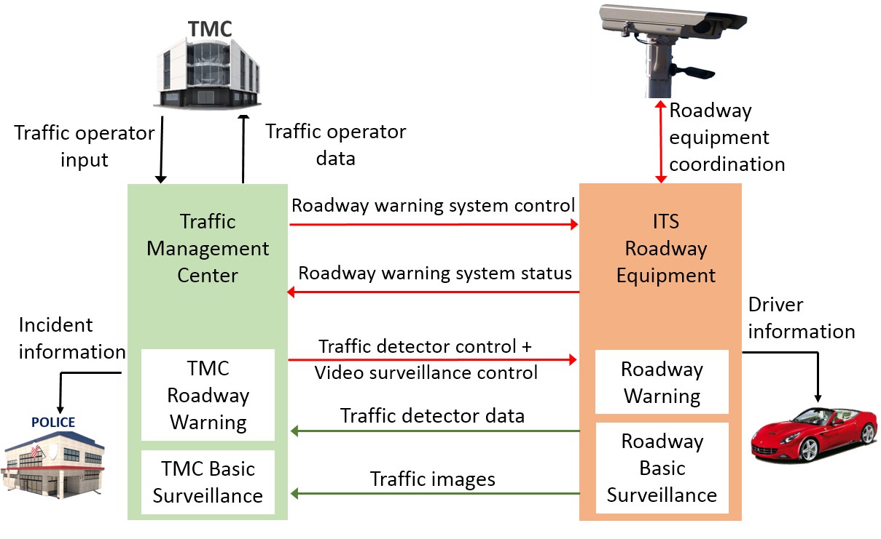
High-Level Functional Architecture

Slide 12
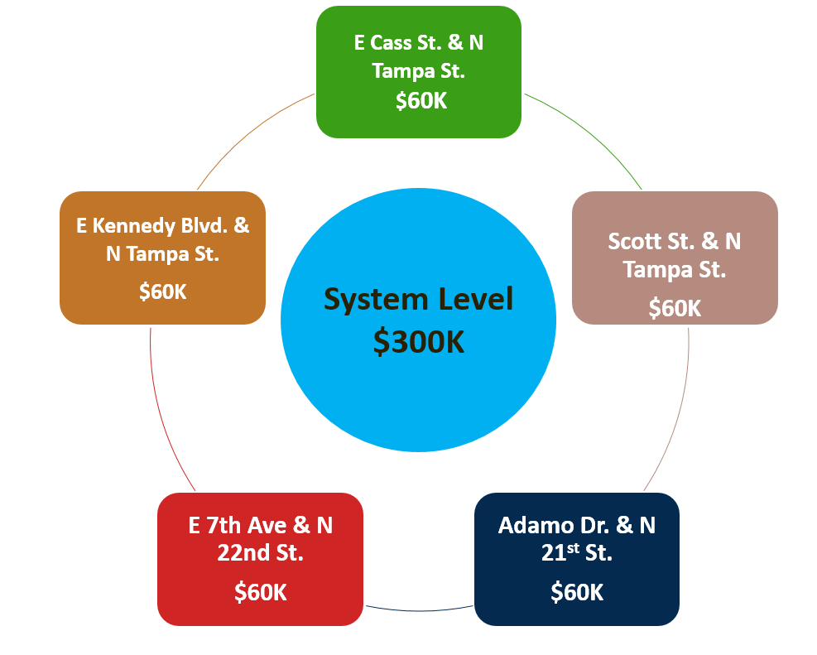
Deployment
Cost Breakdown
Installed Technologies
No Turn LED Signs
Red IIRPMs
Detection-triggered Wrong Way Signs with LED Lights
Thermal Imaging WW Detection System

Slide 13
Project Timeline
Jan-Feb
Feb-Mar
Apr-May
June-Oct
Nov-Dec
Year 2020
Stakeholder Consultation & Needs Assessment
Review of the ConOps
Procurement
System Deployment
System Testing & Validation
Start-August 2019!

Slide 14
Anticipated Benefits
Provide real-time alerts to road users
Adapt to other situations e.g., EMS
Reduce frequency of WWD incidents
Improve incident response time
Reduce traffic violations

Slide 15
Thank You!
Team Members: Cecilia Kadeha
Henrick Haule
Md Sultan Ali
Hector Vargas
Faculty Advisor: Priyanka Alluri
Industry Advisor: Peter Hsu, FDOT District 7
Raj Ponnaluri, FDOT Central Office

