Slide 1
CAT Coalition Technical Resources Working Group Quarterly Meeting
November 13, 2019
11:00-12:30 (Eastern)

Slide 2
Agenda
11:00-11:05 11:05-11:20 11:20-11:30 11:30-11:50 11:50-12:10 12:10-12:25 12:25-12:30 | Welcome and Introductions Outreach and Knowledge Transfer, Resources Recap, CAT Coalition Updates Partner Reports from USDOT, ITSA, ITE CV Deployment Environment Communications 101 Resource CV Procurement State of the Practice Next Webinar, Member Updates, Closing

Slide 3
Outreach and Knowledge Transfer, Resources Recap, CAT Coalition Updates
Jeremy Schroeder and Navin Katta

Slide 4
Ongoing Commitment to Outreach & Knowledge Transfer
Suggestions from WG Members on Ways to Enhance Impact:
Proposed new WG Members
Communications with/involvement in other initiatives
Knowledge resources to include on CAT Coalition website
SPaT deployment, related to the full V diagram
OBU deployment documentation for Connected Fleet Challenge
Cybersecurity and network security resources
New or planned SPaT deployments, or updates

Slide 5
Resources WG Recap
ITE updates
Success bringing MaaS/MOD and CAV communities together
Working to standardize RSUs and SPaT/MAP by creating a pan-national hub of information
CV Deployment Environment resource
Described approach and outline of document
Volunteers will review and provide input to each section before sharing with WG members

Slide 6
Resources WG Recap
Cellular V2X
Overview included current status, benefits, and availability
Resources available at: https://www.qualcomm.com/products/automotive/c-v2x
Introduction to C-V2X: https://www.qualcomm.com/media/documents/files/introduction-to-c-v2x.pdf
C-V2X Experimental License (User Guide): https://www.qualcomm.com/media/documents/files/c-v2x-experimental-license-user-guide.pdf
C-V2X Technology Overview: https://www.qualcomm.com/media/documents/files/c-v2x-technology-overview.pdf
C-V2X ITS Stack: https://www.qualcomm.com/media/documents/files/c-v2x-its-stack.pdf
C-V2X Technical Performance (FAQ): https://www.qualcomm.com/media/documents/files/c-v2x-technical-performance-faq.pdf

Slide 7
CAT Coalition Activities
Strategic Initiatives WG
Connected Fleet Challenge webinars and resources
IOO/OEM Forum
Connected Work Zones: Mapping Toolchain Overview webinar

Slide 8
Connected Fleet Webinar #1
Slides and recording available on the SPaT Challenge Webinar Series webpage: https://transportationops.org/spatchallenge/webinarseries
SPaT Challenge Background and Update – Blaine Leonard, Utah DOT
Connected Fleet Challenge Background – Mark Kopko, PennDOT
Focus on Deployment
PennDOT – Mark Kopko, PennDOT
THEA CV Pilot – Steve Novosad, HNTB
NHDOT SPaT Deployment – Curtis Thompson, Sebago Technics
Q&A
Notes:
Blaine
Review agenda.

Slide 9
Upcoming Connected Fleet Challenge Webinars
Webinar #2 Agenda – November 21, 2019 at 2p ET
SPaT Challenge & Connected Fleet Challenge Background and Update – Blaine Leonard, Utah DOT
Data Collection and OBU Installation Lessons Learned – Bob Rausch, Transcore
Testing V2I Broadcasts for Compatibility with On-board Applications – Jay Parikh, CAMP
Overview of V2I Testing, preparation of a model Test Plan
Installation of CV2X On-board Units – Panasonic’s experiences in CO and UT, including dual DSRC-cellular units – Chris Armstrong or Rob Zimmer, Panasonic
Q&A
Notes:
Blaine
Review agenda.

Slide 10
Upcoming Connected Fleet Challenge Webinars
Webinar #2: November 21, 2019 at 2p ET
Register and more information at: https://transportationops.org/event/webinar-series-connected-fleet-challenge-webinar-2
Webinar #3: January 9, 2020 at 2p ET
Register and more information at: https://transportationops.org/event/webinar-series-connected-fleet-challenge-webinar-3
Notes:
Blaine Leonard
A reminder to folks to join us for the upcoming webinars, which will take place on November 21 and January 9.
Please stay in touch with the SPaT Challenge and Connected Fleet Challenge pages to get updates on specific speakers and topics.

Slide 11
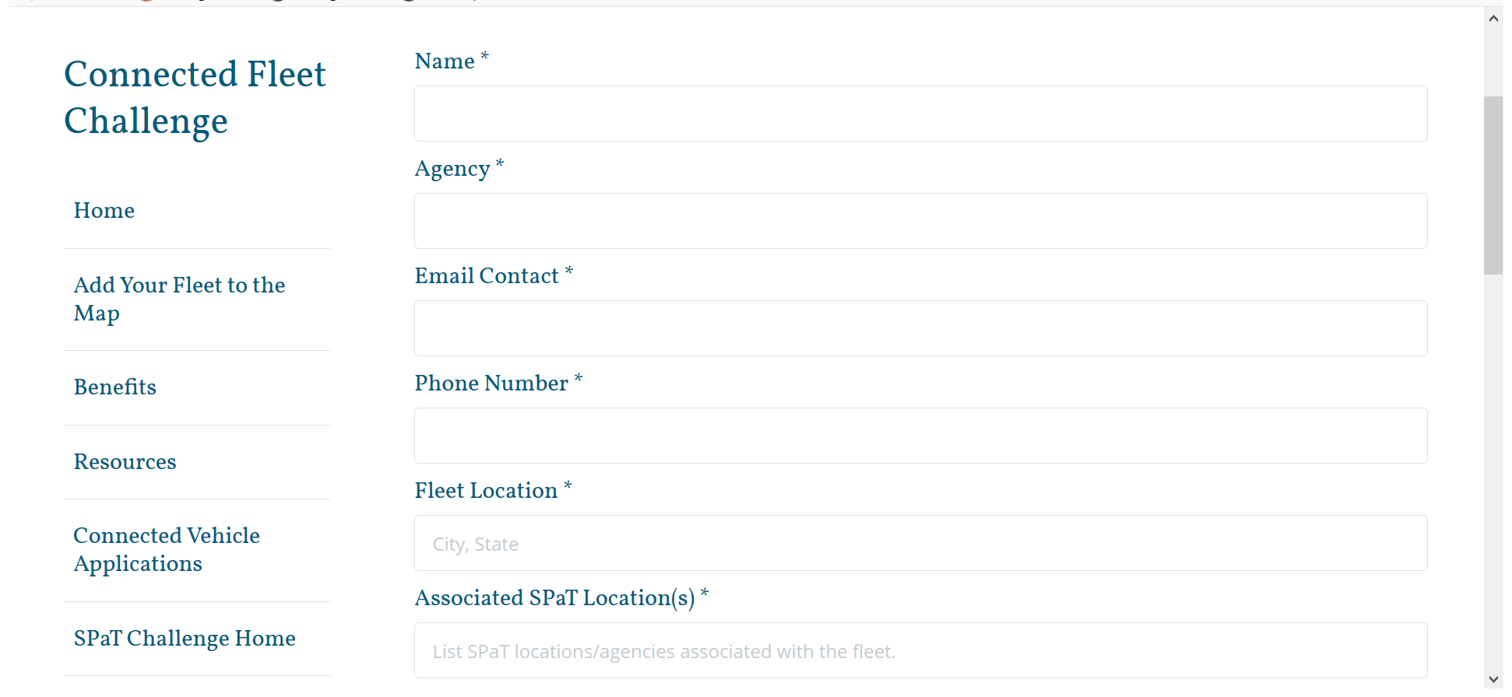
Connected Fleet Challenge Website

Slide 12
Connected Fleet Challenge Request for Information
Sample documentation for deploying agencies to use
Including procurement or bid documents, cost information, lessons learned, general technical resources
Document Connected Fleet Challenge deployment information for map on website
Planned or operational sites
Notes:
Blaine Leonard
This Resources page lists the documents that have been created so far, including the Model ConOps and Reqs that were presented in the previous webinar

Slide 13
Connected Work Zones: Mapping Toolchain Overview
Webinar: November 22, 2019 at 1p ET
Introduce the industry to the availability of the software toolchain and logistics of how to access and use the tool
Encourage the testing and use of the software in order to provide feedback and input to the developers and the CAT Coalition
Understand potential use of the software to support DOTs in creating work zone data to support connected work zones
Register: https://transportationops.org/event/connected-work-zones-mapping-toolchain-overview
Notes:
Blaine Leonard
This Resources page lists the documents that have been created so far, including the Model ConOps and Reqs that were presented in the previous webinar

Slide 14
Partner Reports from USDOT, ITSA, ITE

Slide 15
CV Deployment Environment Discussion
Jeremy Schroeder, Athey Creek

Slide 16
CV Deployment Environment
Resource Objective
Provide a full-picture, high-level overview of the CV environment.
Leverage experiences from CV deployers to document what is needed for an interoperable CV deployment:
Systems, including lifecycle considerations
Connections
General considerations
Reference to standards and other resources, where possible

Slide 17
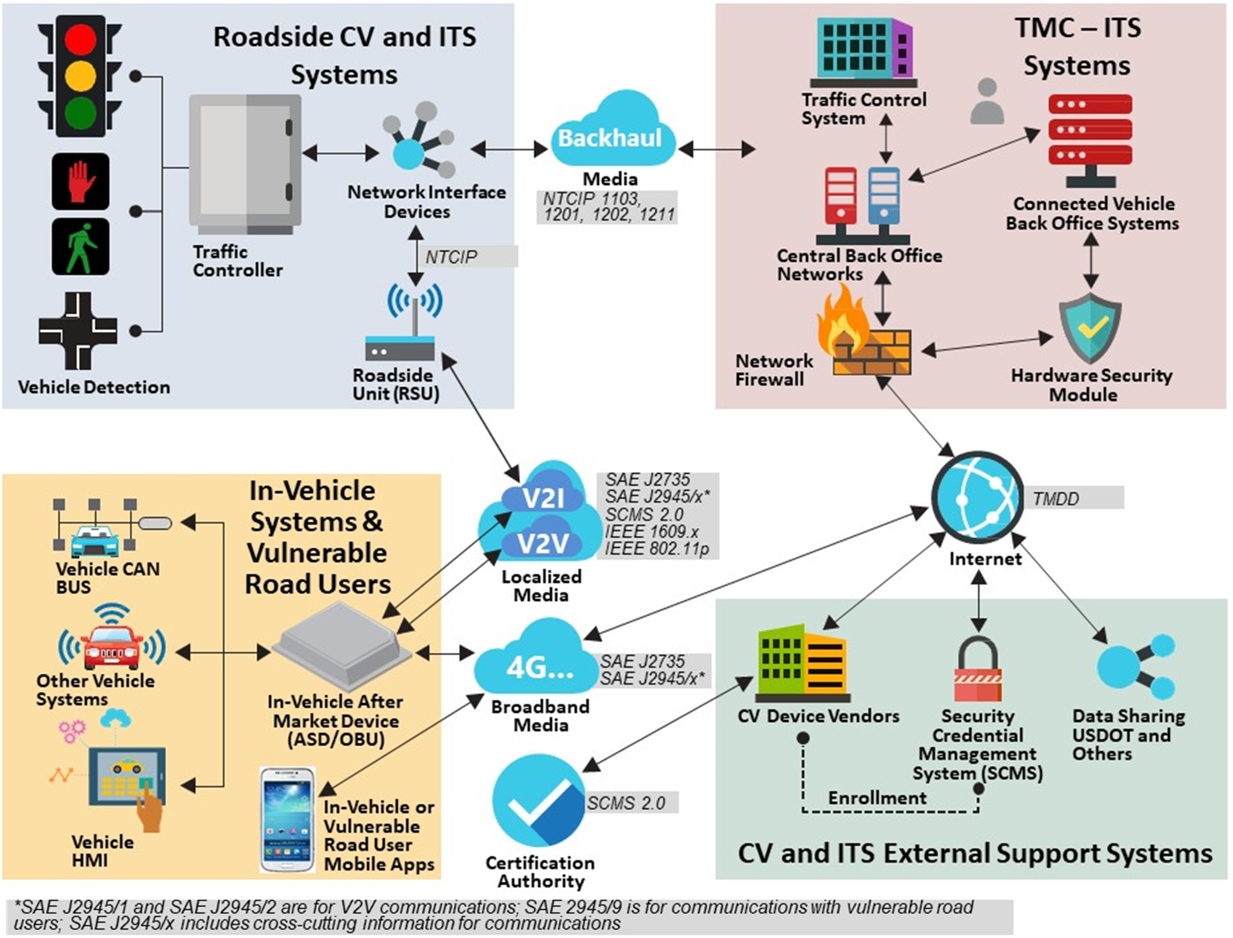
CV Deployment Environment

Slide 18
CV Deployment Environment
Roadside CV and ITS Systems
Draft section shared with volunteer group for their review, input, and comments
Received comments from Ray Starr, Peter Jager, and Israel Lopez
Additional comments welcomed from WG members

Slide 19
CV Deployment Environment
Next steps
Send Roadside CV and ITS Systems section to WG members for additional review and comments
Draft In-Vehicle Systems and Vulnerable Road Users section available for review and input by volunteer group
TMC-ITS Systems and Executive Summary sections being drafted

Slide 20
Communications 101 Resource Content and Discussion
Tracy Larkin-Thomason, Nevada DOT
Jeremy Schroeder, Athey Creek

Slide 21
Communications 101 Overview
Objective and Audience:
Provide IOO executives and decision makers a common understanding about the communications needs, technology options, and terminology for CAT/CAV
Feedback from WG members is requested regarding:
Proposed resources and approach
Organization
Recommendations for additional content, terms, or context
Balanced presentation of technologies
The following slides intended for collaboration, not to be prescriptive.

Slide 22
Communications 101 Overview
Proposed Approach:
Provide resources with small consumable pieces of content on the specific subject that can evolve with the industry as new ideas, technologies, or terminologies emerge, and
Host these resources on a website as:
One or more videos that can be viewed at an executive’s own pace
Presentations that can be used for easily sharing this content in a consistent manner for an in-person meeting format.

Slide 23
Communications 101 Overview
Resources:
PowerPoint presentation of slides that includes graphics and notes with a possible script for use at in-person meetings.
Recorded 3-5 minute webinar that includes a presentation of developed slides and/or animated video while speakers read the developed script.
Schedule:
Complete draft content for entire resource: 12/2019
Finalize content: 2/2020
Record webinar and post to website: 3/2020

Slide 24
Communications 101 Content
Content intends to answer the following questions:
What are the telecommunications methods?
What do the terms mean?
How does DSRC work?
What is the 5.9 GHz spectrum?
What are the V2X benefits of the 5.9 GHz spectrum?
May discuss how OEMs communicate now, e.g. cellular systems like Sirius XM and OnStar
Any other questions that should be answered?

Slide 25
Communications 101 Content Outline
Telecommunications methods
On-Board Units
Network v. Point-to-Point Communications
Roadside Units
Types of Point-to-Point Communications
V2I, V2V, V2X
Cellular and DSRC Communications
5.9 GHz Spectrum
History with FCC, current licensing requirements, security protocols
Benefits
What other terms or topics should be defined or discussed?

Slide 26
Communications 101 Next Steps
Draft content developed to date is sourced from a variety of FCC and USDOT resources
Some content may need to be updated to reflect current circumstances and standards
Will revise draft content based on today’s feedback and then share with WG members with a request for additional comments on:
Organization
Recommendations for additional content, terms, or context
Balanced presentation of technologies

Slide 27
Telecommunications Methods
Common in vehicles: Bluetooth, Sirius XM, and cellular, which includes OnStar.
Vehicles are beginning to be equipped with technologies and agencies are beginning to deploy infrastructure, both of which leverage one or more available communications technologies to exchange data and information using secure, interoperable networked wireless communications.

Slide 28
On-Board Units
An OBU is a transceiver that is normally mounted in or on a vehicle, or in some instances may be a portable unit.
OBUs will communicate with the infrastructure through either network communications or point-to-point communications.

Slide 29
Network v. Point-to-Point Communications
Network communications are wide area communications that may provide a connection via the cloud to devices and infrastructure systems.
Point-to-point communications take place across short distances and directly between two OBUs, or between an OBU and roadside infrastructure called Roadside Units (RSUs).

Slide 30
Roadside Units
An RSU is a transceiver that is mounted along a road or pedestrian passageway.
An RSU may also be mounted on a vehicle or hand carried, but it may only operate when the vehicle or hand-carried unit is stationary.
An RSU broadcasts data to OBUs or exchanges data with OBUs in its communications zone.

Slide 31
Types of Point-to-Point Communications
Point-to-point communications to exchange data and information can be delineated into three categories:
Vehicle-to-Infrastructure (V2I) communications are between vehicles and infrastructure systems.
Vehicle-to-Vehicle (V2V) communications are between different vehicles.
Vehicle-to-Everything (V2X) communications are between vehicles and passengers’ personal communications devices.

Slide 32
Cellular and DSRC Communications
Cellular communications use existing 4G LTE networks like a personal mobile phone, and also include future 5G deployment. This is referred to as Cellular-V2X or C-V2X. An advantage of cellular communications is reaching vulnerable road users through their personal cellular devices.
Notes:
Cellular communications using existing 4G LTE networks like a personal mobile phone, and also include future 5G deployment. This is referred to as Cellular-V2X or C-V2X. An advantage of cellular communications is reaching vulnerable road users through their personal cellular devices.
Dedicated short range communications, commonly referred to as DSRC, is defined by the U.S. Department of Transportation as “a two-way short-to-medium-range wireless communications capability that permits very high data transmission critical in communications-based active safety applications”. ² The FCC notes that “the DSRC Service involves vehicle-to-vehicle and vehicle-to-infrastructure communications, helping to protect the safety of the traveling public. It can save lives by warning drivers of an impending dangerous condition or event in time to take corrective or evasive actions”. DSRC offers a proven, low-latency communications method that is required for some safety applications.
Both cellular and DSRC communications methods could be deployed for similar purposes.
Regardless of the communications approach, network communications will be supported by wired backhaul communications. RSUs in the field will need backhaul communications to centralized centers. This backhaul communications may be fiber, cellular, or other communications the agency operates.

Slide 33
Cellular and DSRC Communications
Dedicated short range communications, commonly referred to as DSRC, is defined by the USDOT as “a two-way short-to-medium-range wireless communications capability that permits very high data transmission critical in communications-based active safety applications”. The FCC notes that “the DSRC Service involves vehicle-to-vehicle and vehicle-to-infrastructure communications, helping to protect the safety of the traveling public. It can save lives by warning drivers of an impending dangerous condition or event in time to take corrective or evasive actions”. DSRC offers a proven, low-latency communications method that is required for some safety applications.
Notes:
Cellular communications using existing 4G LTE networks like a personal mobile phone, and also include future 5G deployment. This is referred to as Cellular-V2X or C-V2X. An advantage of cellular communications is reaching vulnerable road users through their personal cellular devices.
Dedicated short range communications, commonly referred to as DSRC, is defined by the U.S. Department of Transportation as “a two-way short-to-medium-range wireless communications capability that permits very high data transmission critical in communications-based active safety applications”. ² The FCC notes that “the DSRC Service involves vehicle-to-vehicle and vehicle-to-infrastructure communications, helping to protect the safety of the traveling public. It can save lives by warning drivers of an impending dangerous condition or event in time to take corrective or evasive actions”. DSRC offers a proven, low-latency communications method that is required for some safety applications.
Both cellular and DSRC communications methods could be deployed for similar purposes.
Regardless of the communications approach, network communications will be supported by wired backhaul communications. RSUs in the field will need backhaul communications to centralized centers. This backhaul communications may be fiber, cellular, or other communications the agency operates.

Slide 34
Cellular and DSRC Communications
Both cellular and DSRC communications methods could be deployed for similar purposes.
Regardless of the communications approach, network communications will be supported by wired backhaul communications. RSUs in the field will need backhaul communications to centralized centers. These backhaul communications may be fiber, cellular, or other communications the agency operates.
Notes:
Cellular communications using existing 4G LTE networks like a personal mobile phone, and also include future 5G deployment. This is referred to as Cellular-V2X or C-V2X. An advantage of cellular communications is reaching vulnerable road users through their personal cellular devices.
Dedicated short range communications, commonly referred to as DSRC, is defined by the U.S. Department of Transportation as “a two-way short-to-medium-range wireless communications capability that permits very high data transmission critical in communications-based active safety applications”. ² The FCC notes that “the DSRC Service involves vehicle-to-vehicle and vehicle-to-infrastructure communications, helping to protect the safety of the traveling public. It can save lives by warning drivers of an impending dangerous condition or event in time to take corrective or evasive actions”. DSRC offers a proven, low-latency communications method that is required for some safety applications.
Both cellular and DSRC communications methods could be deployed for similar purposes.
Regardless of the communications approach, network communications will be supported by wired backhaul communications. RSUs in the field will need backhaul communications to centralized centers. This backhaul communications may be fiber, cellular, or other communications the agency operates.

Slide 35
5.9 GHz Spectrum
In October 1999, the Federal Communications Commission (the FCC) allocated the 5.9 GHz band for DSRC-based ITS applications and adopted basic technical rules for DSRC operations.
In 2006, the FCC adopted a Memorandum Opinion and Order which, among other decisions, designated Channels 172 and 184 for public safety applications involving safety of life and property. These dedicated channels for connected vehicle communications ensures that the wireless network is available to vehicle needs without fear of interference that could result in harmful situations.
Notes:
In October 1999, the Federal Communications Commission (the FCC) allocated the 5.9 GHz band for DSRC-based ITS applications and adopted basic technical rules for DSRC operations.
In 2006, the FCC adopted a Memorandum Opinion and Order which, among other decisions, designated Channels 172 and 184 for public safety applications involving safety of life and property. ¹ These dedicated channels for connected vehicle communications ensures that the wireless network is available to vehicle needs without fear of interference that could result in harmful situations.³
DSRC licensees must register RSU sites, channels, and other relevant data on the Universal Licensing System (ULS) under the call sign of the relevant license.
DSRC is a wireless technology that has more security and privacy protections than traditional Wi-Fi. DSRC only has a range of 1,000 feet, meaning many attacks would require close proximity. Since safety concerns predominately involve moving vehicles, there is a very short window for attack.⁴
Connected vehicles require advanced wireless technology to communicate with other vehicles and roadside infrastructure. The dedicated short-range communications (DSRC) must be fast, reliable, and secure to ensure the transmission of critical safety messages without delay or interference.

Slide 36
5.9 GHz Spectrum
DSRC licensees must register RSU sites, channels, and other relevant data on the Universal Licensing System (ULS) under the call sign of the relevant license.
DSRC is a wireless technology that has more security and privacy protections than traditional Wi-Fi. DSRC only has a range of 1,000 feet, meaning many attacks would require close proximity. Since safety concerns predominately involve moving vehicles, there is a very short window for attack.
Notes:
In October 1999, the Federal Communications Commission (the FCC) allocated the 5.9 GHz band for DSRC-based ITS applications and adopted basic technical rules for DSRC operations.
In 2006, the FCC adopted a Memorandum Opinion and Order which, among other decisions, designated Channels 172 and 184 for public safety applications involving safety of life and property. ¹ These dedicated channels for connected vehicle communications ensures that the wireless network is available to vehicle needs without fear of interference that could result in harmful situations.³
DSRC licensees must register RSU sites, channels, and other relevant data on the Universal Licensing System (ULS) under the call sign of the relevant license.
DSRC is a wireless technology that has more security and privacy protections than traditional Wi-Fi. DSRC only has a range of 1,000 feet, meaning many attacks would require close proximity. Since safety concerns predominately involve moving vehicles, there is a very short window for attack.⁴
Connected vehicles require advanced wireless technology to communicate with other vehicles and roadside infrastructure. The dedicated short-range communications (DSRC) must be fast, reliable, and secure to ensure the transmission of critical safety messages without delay or interference.

Slide 37
5.9 GHz Spectrum
Connected vehicles require advanced wireless technology to communicate with other vehicles and roadside infrastructure. The dedicated short-range communications (DSRC) must be fast, reliable, and secure to ensure the transmission of critical safety messages without delay or interference.
Notes:
In October 1999, the Federal Communications Commission (the FCC) allocated the 5.9 GHz band for DSRC-based ITS applications and adopted basic technical rules for DSRC operations.
In 2006, the FCC adopted a Memorandum Opinion and Order which, among other decisions, designated Channels 172 and 184 for public safety applications involving safety of life and property. ¹ These dedicated channels for connected vehicle communications ensures that the wireless network is available to vehicle needs without fear of interference that could result in harmful situations.³
DSRC licensees must register RSU sites, channels, and other relevant data on the Universal Licensing System (ULS) under the call sign of the relevant license.
DSRC is a wireless technology that has more security and privacy protections than traditional Wi-Fi. DSRC only has a range of 1,000 feet, meaning many attacks would require close proximity. Since safety concerns predominately involve moving vehicles, there is a very short window for attack.⁴
Connected vehicles require advanced wireless technology to communicate with other vehicles and roadside infrastructure. The dedicated short-range communications (DSRC) must be fast, reliable, and secure to ensure the transmission of critical safety messages without delay or interference.

Slide 38
Benefits
Recognizing the critical need for point-to-point communications, and the frequencies needed to achieve the low latency communications, the FCC allocated 5.9 GHz spectrum to achieve a variety of safety, mobility, and environmental benefits. These benefits may be realized by using applications that have been developed, tested, and implemented as described by USDOT. (see notes)
Improved Safety…
Improved Mobility…
Environmental benefits…
Notes:
Improved safety. Connected vehicle technology has the potential to significantly prevent or reduce the impact of millions of accidents every year. By limiting the number of crashes, thousands of lives will be saved and millions of injuries prevented. The technology will alert users of potentially dangerous situations that are developing and provide you with the tools to avert crashes or reduce their consequences. Vehicles will transmit, receive, and continually monitor signals that will provide it with a 360-degree view of other vehicles nearby. The system will operate in the background and only alert the user if an unsafe situation is developing. In many situations, the user will be warned of dangers that he or she is not aware of and can't even see.
Improved mobility. Increased mobility is one of the main benefits that connected vehicle technology offers. Transportation and traffic managers can use the data generated by vehicles on the roads and rails, by sensors imbedded in the infrastructure, and by mobile devices such as smartphones to keep traffic flowing smoothly. And new mobility applications will enable users to plan the most efficient, time-saving, and greenest commute.
Environmental benefits. Connected vehicle technology has the potential to make a significant contribution to reducing the environmental impact of surface transportation. It can give users the information needed to make eco-friendly travel choices—those choices that mitigate some of the negative impacts of surface transportation, such as congestion and tailpipe emissions. By providing users with real-time data collected from connected vehicles, the connected infrastructure, and personal information devices such as smartphones, users will know which form of travel to your destination will have the least environmental impact. With up-to-the-minute information on traffic conditions, users will be able to find alternate routes, decide to take public transit, or reschedule your travel to when traffic is less congested.

Slide 39
CV Technology Procurement State of the Practice Analysis
Greg Hatcher, Noblis

Slide 40
Closing Remarks
Any deployment updates or lessons learned to share with the group?
Any other closing comments or questions?
Next Resources WG Meeting
February 12, 2020
11:00-12:30 (Eastern)

