Slide 1
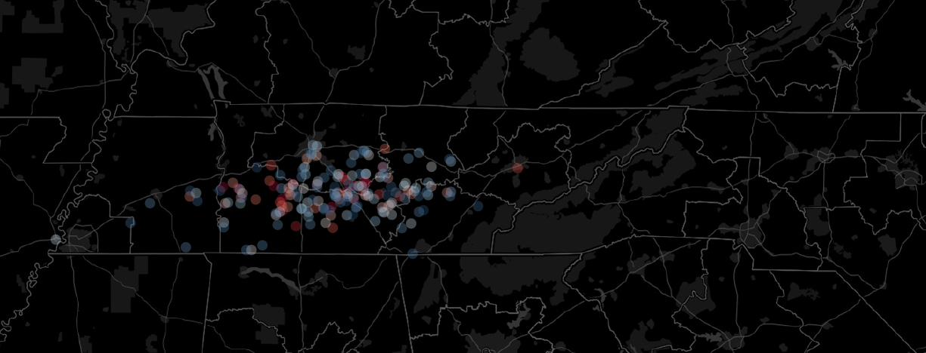
A New Tool for Signalized Intersection Performance Assessment

Slide 2
OUR Team
Nima Hoseinzadeh
Yuandong Liu
Zhihua Zhang
Ava Hedayatipour
Michael Han
Danting Zhao
Data
Meeting Time
Address
Waze Travel time Data provided by TDOT | intersection Signal Timing Plan
Weekly Meetings
311 John D. Tickle Building,
851 Neyland Drive, Knoxville, TN 37996
2/13

Slide 3
OUTLINE
01
Problem Description
Objectives, Requirements, Stakeholders, and Scope …
02
Proposing Solution
Data Description, LOS, Delay calculation …
03
Benefits
Expected benefits and Implementation
04
Cost Breakdown and Timeline
Costs, needs, Timeline …
05
Summary
Wrap up, questions …
3/13

Slide 4
Problem Description
Tennessee
6,000
Operating Traffic Signal in TN
4/13
Source: http://tsite.org/wp-content/uploads/2012/11/Presentation-1-%E2%80%93-Tennessee-Traffic-Signal-Users-Group-TTSUG.pdf
Notes:
There are around six thousand operating signalized intersections in Tennessee.
Local agencies are typically the owner of these signals and rely on contractors to maintain the signals.
A survey conducted by Tennessee Traffic signal User group (TTSUG) showed that about 54 percent of signals agencies are small agencies which manage only 20 signal or less.
Also, this survey showed that signal retiming period for most of the intersections are more than two years. Most of the agencies do not have enough budget for installing automated equipment. This can cause performance degradation, delay and deficiency.
Meanwhile, different agencies own different signal devices which is challenging to aggregate them in network.

Slide 5
Objectives
Using crowdsourced data to
- Calculate the performance of signalized intersections
- Identify and Rank deficient traffic signals
- Improve signal timing plans in a network level
Retiming based on local complaints and crash statistics fluctuations
Lack of expertise for signal retiming
Proposed Solution
High Cost of installing new devices
Our proposed solution is to develop an automatic system-wide tool using crowdsourced data to evaluate the signalized intersections on a routine and real-time basis, which is independent of local complaints and crash statistics fluctuations.
Lack of system-wide performance assessment
5/13

Slide 6
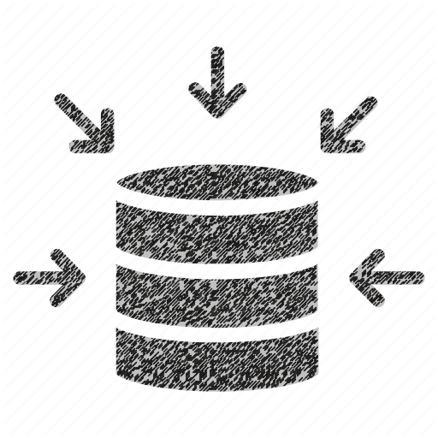
Partners (University and Contractors)
Research Projects
Implementation
Stakeholders
Requirements
Scopes
Users (Road Users, Commercial drivers)
As Probe vehicle
TDOT
Policy
Supervision
Funding
Data Provider (Waze, TDOT)
Crowdsourced real-time data
Signal Timing Plan
Scope
What we need:
- Crowdsourced data (Waze) for state intersection
- Intersections GIS data
This Project:
- Focus on signalized intersections in Tennessee
- Is a Research Project
- Has some limitation due to data availability
Requirements
6/13
Notes:
The stakeholders of this solution are:
TDOT with supervision, funding and policy making
University and contractors are also doing the research projects and implementation.
Data provider like Waze
And road user which perform the role probe vehicle and benefits from increasing the performance.

Slide 7
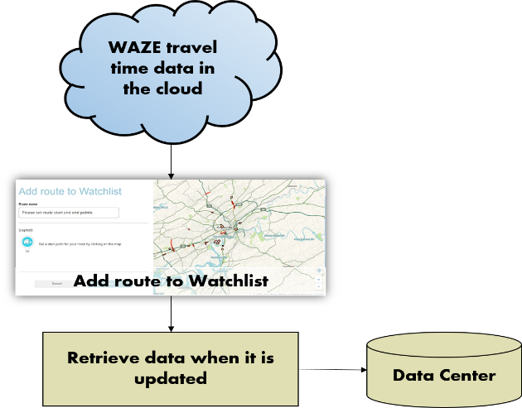
Proposed Solution
 | Traditional Method | Propose Solution
Data | Turning Movements, Arriving rates, Signal timing plan | Waze Travel Time Data
Delay | Average Control Delay | Average Travel Time Delay
Performance Measures | Level of Service(LOS) | Derive New Measurement
7/13

Slide 8
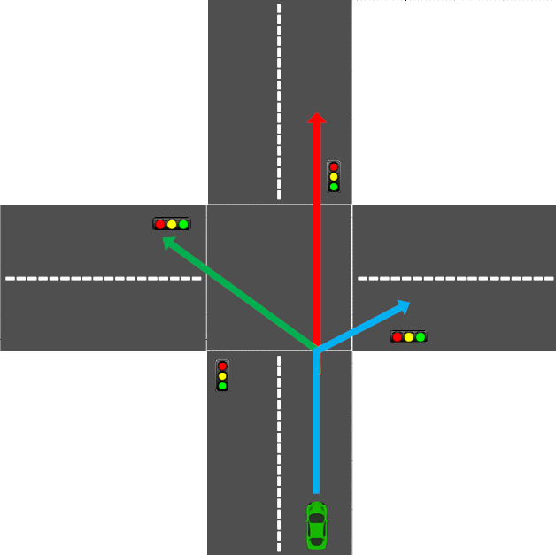
$$Downstram P_{d}$$
$$Downstram P_{ld}$$
$$Downstram P_{rd}$$
$$Upstram P_{U}$$
$$\overline{D}=\overline{T}−T_{e}$$
Delay Computation:
8/13

Slide 9
Collect and Archive Waze Travel Time
Compute Average Travel Time Delay
Evaluate Performance and Generate Performance Reports
01
Prioritize Signalized Intersection and Identify Deficient Intersections
02
Signal Retiming and Before-After Analysis
03
04
05
9/13

Slide 10
Advantages and Expected Benefits
Robust System
Provide a robust signal retiming decision work flow independent to local complaints and crash statistics fluctuations.
Automate the work flow for triaging all or any number of the signalized intersections at the choosing of TDOT or other agencies.
Automatic System
Provide a low-cost performance management system, no additional hardware/infrastructure investments are needed.
Low Cost System
The recognized early signs of deficiency and recommended retiming of signalized intersection can reduce queue spillback onto freeways or next intersection. This should result in safety improvements
Safety Benefits
Operational Benefits
Reduce delay and congestions
10/13

Slide 11
Timeline
Task 6 Technology Transfer
Technology Transfer
Automation Tool User Workshop
Task 5 Automation Tool Development
Automation Tool Development
Task 4 Before-After Analysis
Prioritize Corridors
Prioritize intersections
Before-After analysis
Task 3 Performance Measurements
Delay Computation
Identify Suitable Performance Measures
Task 2 Data Management
Rea-time data inventory
Data management
Task 1 Study Sites Selection
Waze data quality report
Intersection selection
Route creation
Jan | Feb | Mar | Apr | May | Jun | Jul | Aug | Sep | Oct | Nov | Dec | Jan | Feb | Mar | Apr | May | Jun
2020
2021
11/13

Slide 12
Cost Breakdown ($150k)
Task 1 Study Sites Selection
Task 2 Data Management
Task 3 Performance Measurements
Task 4 Before-After Analysis
Task 5 Automation Tool Development
Task 6 Technology Transfer
12/13

Slide 13
Summary
A problem of traffic signal management in Tennessee is discussed
This method uses readily-available crowdsourced data to calculate travel time delay and generate performance reports.
An automatic system-wide assessment of intersections performance tool will be developed.
This tool helps TDOT to analyze deficient signalized intersections to better allocate funding.
This solution helps for signal retiming and in a higher level provides the basis for a real-time dynamic signal timing.
13/13

Slide 14
Thank You

