Slide 1
Corridor Management in I-75/I-696 Influence Area
University of Michigan
(Presenting) Alex Sundt, Yan Zhao, Xiaotong Sun,
Shihong Huang, Guoyang Qin, Amir Tafreshian,
(Advisor) Dr. Neda Masoud
In collaboration with MDOT

Slide 2
Influence area
Troy
Highway
Densely Populated Area
Traffic Attractions
Traffic Productions
Influence Area
Warren
Southfield
GM Tech Center
Chrysler Truck Assembly Plant
GM Detroit/Hamtramck Assembly Plant
Downtown Detroit

Slide 3
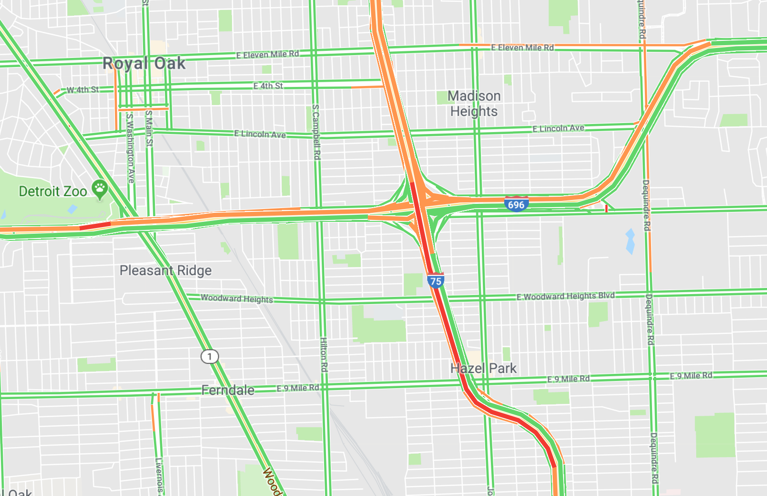
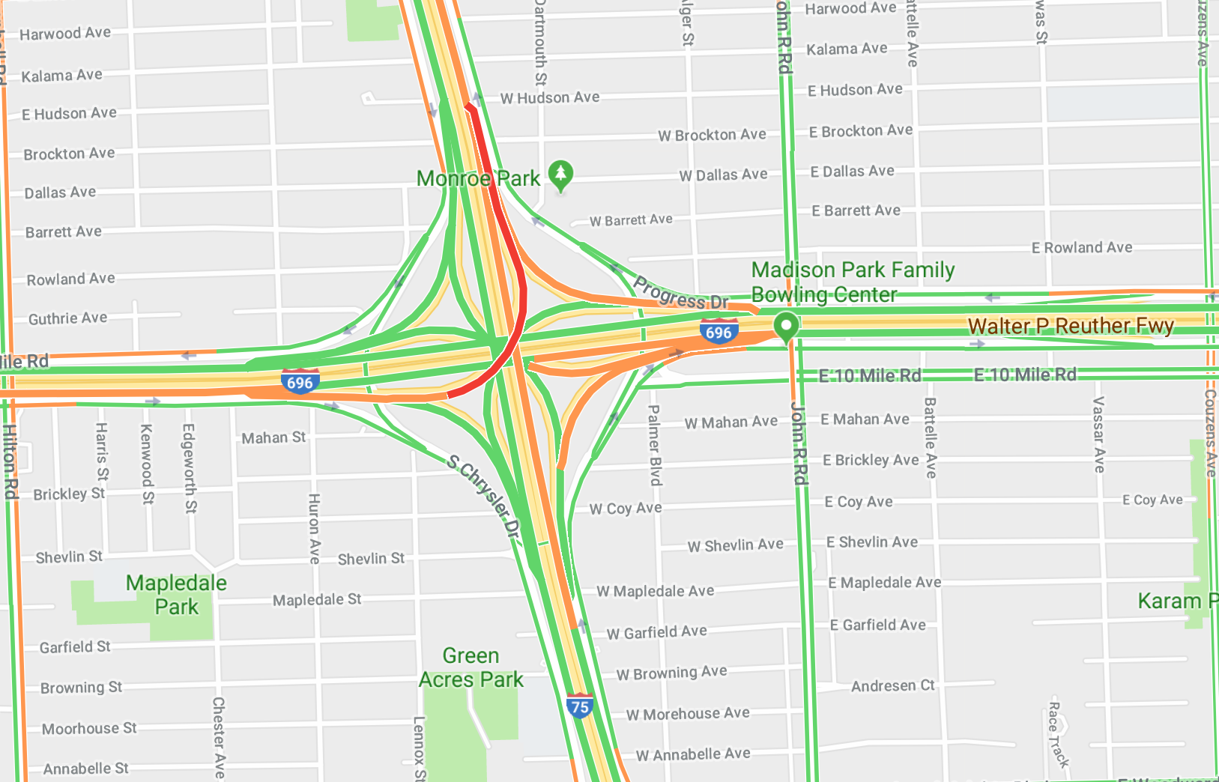
Problem: recurring congestion
Morning Congestion: North to South
Evening Congestion: South/West to North
 | N I-75 | S I-75 | E I-696 | W I-696
Interchange Upstream | 94,500 | 45,700 | 102,900 | 71,100
Interchange Downstream | 72,800 | 68,300 | 102,900 | 71,100
 | E I-696 | W I-696
N I-75 | 27,900 | 14,200
S I-75 | 18,900 | 28,500
 | N I-75 | S I-75
E I-696 | 21,000 | 11,600
W I-696 | 16,800 | 28,500
Notes:
Use existing network

Slide 4
Negative impacts
Poor travel time reliability
More accidents due to stop-and-go traffic
Higher energy consumption and emissions
Congestion led to $305B loss in 2017 nationwide (INRIX study)

Slide 5
Existing management
I-75 and I-696 operated and maintained by MDOT
Freeway Courtesy Patrol service responds to accidents
ITS deployments
Dynamic Message Signs, CCTV cameras
Signalized Arterials
Low speed limits
Local arterial roads are maintained by different agencies

Slide 6
Two-part solution
Regulating vehicle flow
Supply-focused
Same # of vehicles
but smoother & faster traffic
Shuttle buses + carpooling
Demand-focused
Same # of trips
but fewer vehicles
Notes:
ELABORATE
SUPPLY: DO NOT LIMIT NUMBER OF VEHICLES USED, BUT ONLY REGULATE THEM
Demand side: shrink the number of vehicles but not the trips

Slide 7
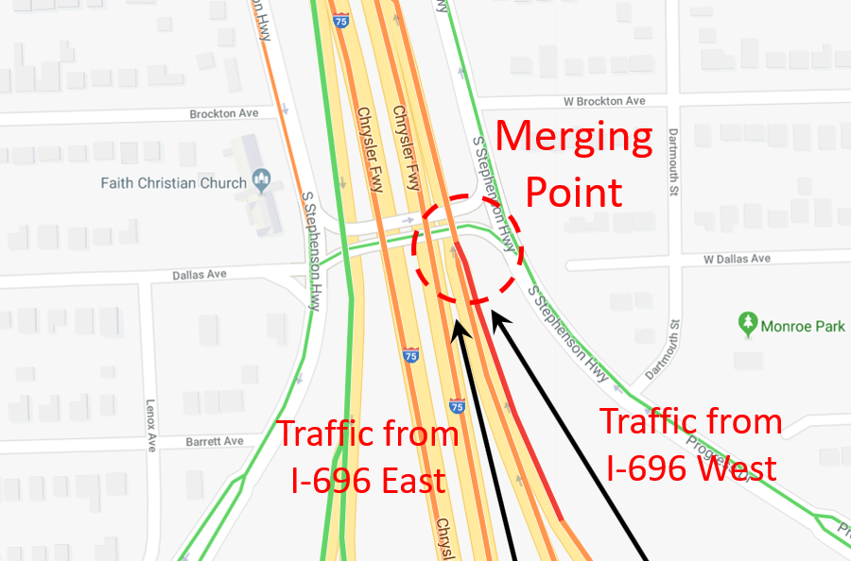
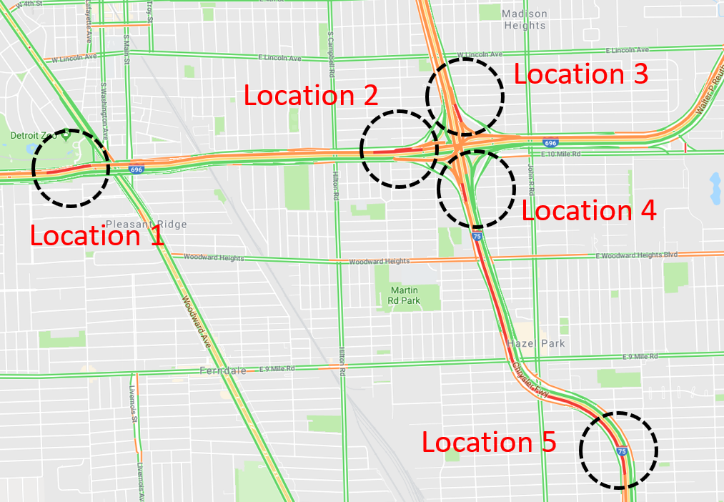
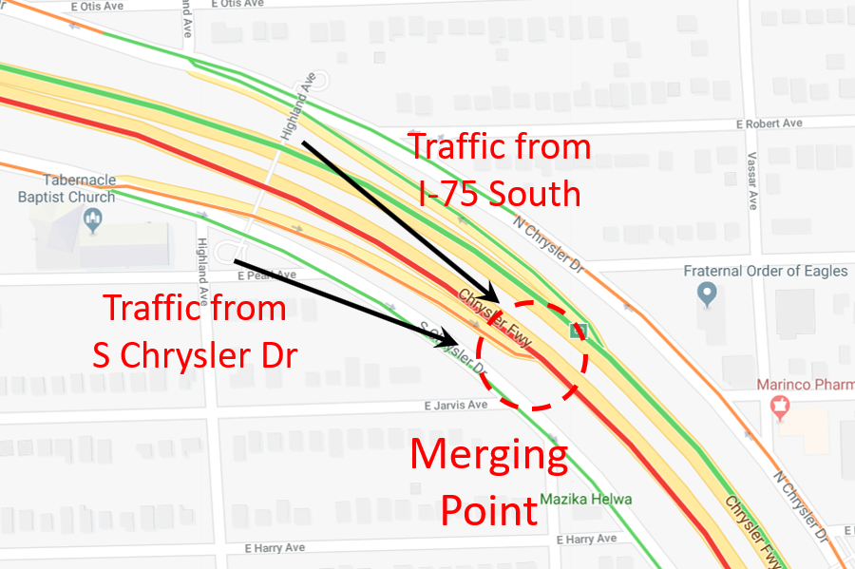
Typical peak-hour traffic
Freeway ↔ Freeway
Merging points are the bottlenecks
Local → Freeway
Morning travel speed
Notes:
We obtained a visualization of the historical travel speed data from Google Maps.
When we investigate the distribution of travel speeds, we found that the merging points are the bottlenecks.
Use animation
Practice more

Slide 8
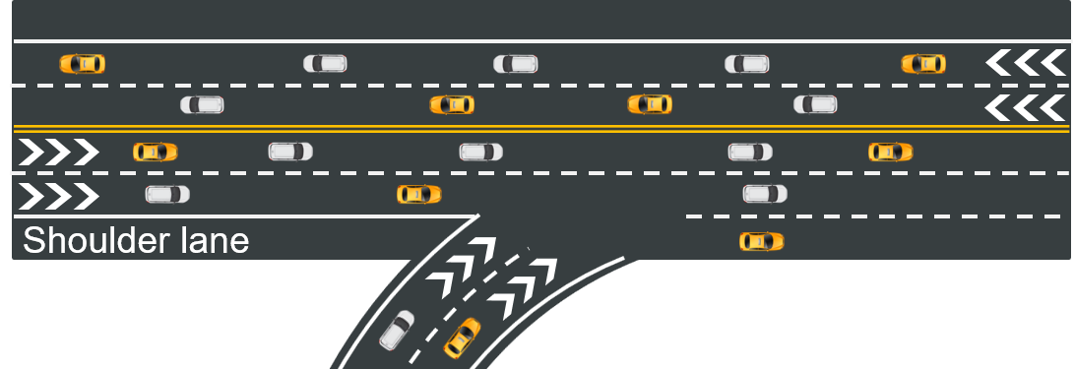
Solution to freeway-freeway congestion
Dynamic junction control
Dynamically allocates lane access in the interchange area
Example: an extended use of a shoulder lane
Dynamic merge control
Manages the entry of vehicles into merge areas
Example: portable dynamic message signs
Merge ahead

Slide 9
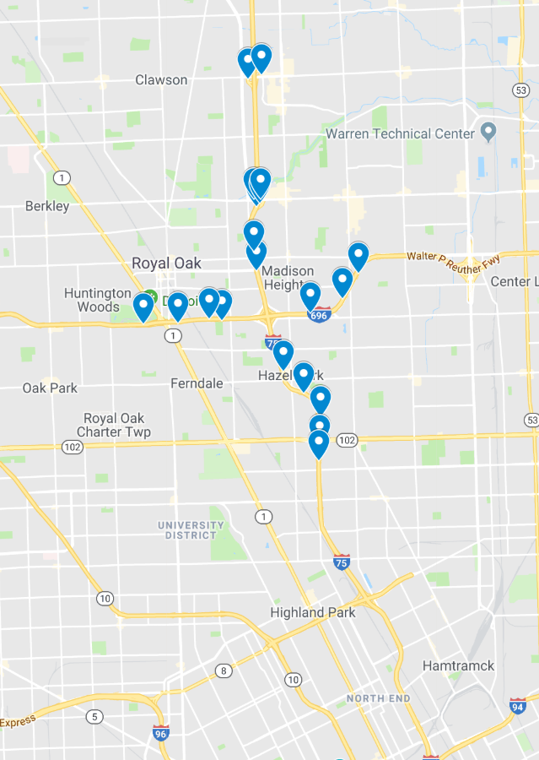
Solution to local-freeway congestion
Adaptive ramp metering
Controls the traffic density on freeways
Allows for efficient use of the existing freeway capacity
Arterial green-wave signal control
Allows rerouted traffic to flow smoothly
Downtown Detroit
Notes:
TODO:
Diagram of a map with meters and green waves
Slide 7, big pics with small zoomed-in pics
Cost breakdown: size of the area, ask ED

Slide 10
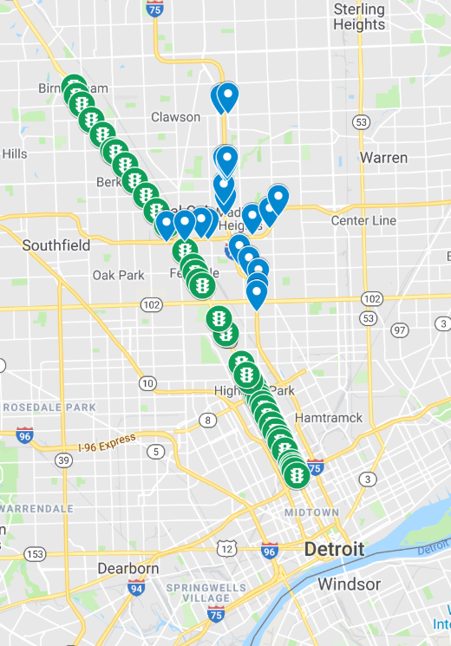
Cost breakdown and timeline
Cost
Timeline
 | Description | Quantity | Unit Price | Subtotal
1 | Ramp meter | 20 | $40,000 | $800,000
2 | Portable dynamic message sign | 10 | $5,000 | $50,000
3 | Traffic signal retiming | ~20 | $3,000 | $60,000
 |  |  |  | $910,000
Task | Time Estimate
Ramp meter installation | 3 months
Portable dynamic message sign | 1 month
Traffic signal retiming | 1 month
Notes:
Demand side: why companies participate: parking constraints
Can be outsourced
Conclusion slide
add a slide for stakeholders on the supply side

Slide 11
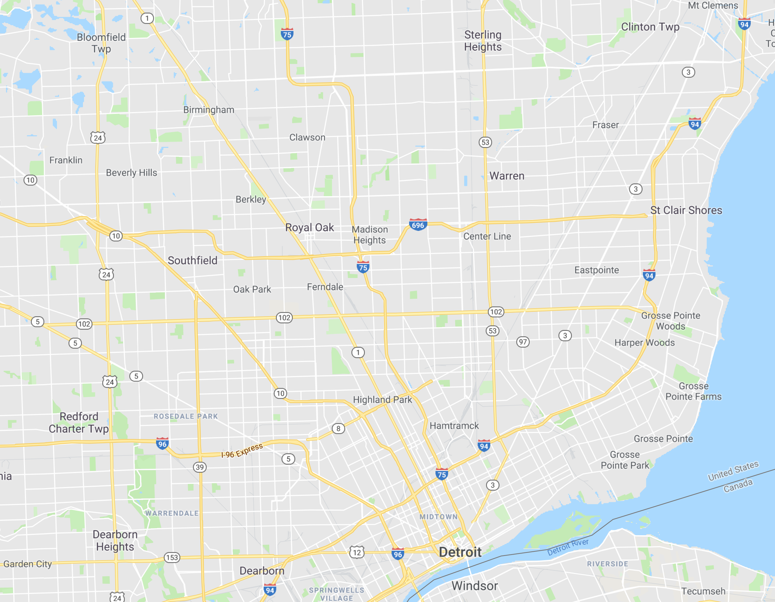
Demand-focused solutions
Commuting trips to downtown Detroit and big companies
Company-led, MPO-assisted: Integrating the commuting trips for employees
Win-win cooperation
Two suggested solutions: shuttle-based and carpool-based
Home
GM Tech Center
Chrysler Truck Assembly Plant
GM Detroit/Hamtramck Assembly Plant
Work
Notes:
Companies have the motivation to do so because they struggling with parking issues and work productivity.
Comparing to

Slide 12
Shuttle-based solutions
On-demand transit services with customized routes
Optimized for the employees better
Cooperate with MPOs and local transit agencies for route planning and infrastructure usage
Two possible business models
Outsourcing: bundle demand, resort to public transit provider
Company-owned shuttles: same destination, semi door-to-door services
Notes:
Comparing to traditional TDM

Slide 13
Functional architecture
Traffic Management Center
Route Planning
Personal Information Device
Real-time Traffic Condition
Service
Center
Personal Trip Planning and Route Guidance
Passengers
(Employees)
Alternative Mode Transportation Center
Backup Plan
Trip Planning
Vehicle OBE
Transit Management Center
Data Collection
Transit Center Connection Protection
Shuttle Trip Planning and Route Guidance
Drivers
MDOT, MPOs, local governments, etc.
Companies and platforms
Vehicles and users
Stakeholders
Notes:
Highlight companies will be responsible for this.
Arranging the use of bus stops
Mobility service for different communities

Slide 14
Carpool-based solution
Car-pooling among colleagues
Flexible departure time and route choices
Companies provide compensations or rewards for car-pooling behaviors
Personal Information Device
Potential Partner
Passengers
Platform
Data Collection
Vehicle OBE
Trip Matching
Rewarding
Potential Partners and Route Guidance
Drivers

Slide 15
Cost breakdown and timeline
Cost
Timeline
Company-owned shuttles (per year)
 | Description | Quantity | Unit Price | Subtotal
1 | Shuttle bus (life cycle: 12 years) | 10 | $5,000 | $50,000
2 | Operation cost (labor, fuel) | 10 | $65,200 | $652,000
3 | API development cost | 1 | $100,000 | $100,000
 |  |  |  | $852,000
Car-pooling policy
 | Description | Quantity | Unit Price | Subtotal
1 | API development cost | 1 | $100,000 | $100,000
2 | Mileage compensation | 1000 | $300 | $300,000
3 | Parking compensation | 1000 | $100 | $100,000
$500,000
Task | Time Estimate
Stakeholder meetings | 1 month
Public hearing | 3 months
Scheduling determination | 1 month
Trial operation | 2 months
Notes:
Adam Hopps (NOCoE): Total Presentation Time: 11 minutes 30 seconds.
David Jackson (USDOT Volpe Ctr): Expanded Problem Statement & Solution was made to be relevant beyond Detroit
David Jackson (USDOT Volpe Ctr): May want to spend a little more time on the SUPPLY COST slide (rough with 11 minutes right now)
David Jackson (USDOT Volpe Ctr): Alex's upfront section was much improved, but may want to streamline his remarks some to provide time for the solutions
David Jackson (USDOT Volpe Ctr): EGAN has joined - another judge for next week. Any comments?
David Jackson (USDOT Volpe Ctr): BUSINESS MODELS - will the shuttles impact revenue generation by the transit agency(ies)? COSTS - any option to contract with Public Transit provider for shuttles (be prepared for judges to inquire about pros/cons for the shuttles)
David Jackson (USDOT Volpe Ctr): DEMAND - Proposing TDM solutions, perhaps at an expanded scale. May want to differentiate or mention how this is beyond the traditional TDM. Also, with TDM, MPO should be invovled.

Slide 16
Summary
Freeway congestion is a universal problem across the country and around the world.
To mitigating the I-75/I-696 corridor congestion without expanding the network, we propose a targeted combination of solutions:
the supply-focused solution regulates vehicles on roads,
the demand-focused solution reduces the car trips instead of personal trips.
Coordination among different transportation agencies, among governments, companies and personal travelers is the key to success.

Slide 17
Thank you!
Team members
Shihong Huang
Guoyang Qin
Xiaotong Sun
Alex Sundt
Amir Tafreshian
Yan Zhao
Academic Advisor
Dr. Neda Masoud
Special thanks to MDOT
Mike Wroblewski
Collin Castle
Tony Kratofil

Slide 18
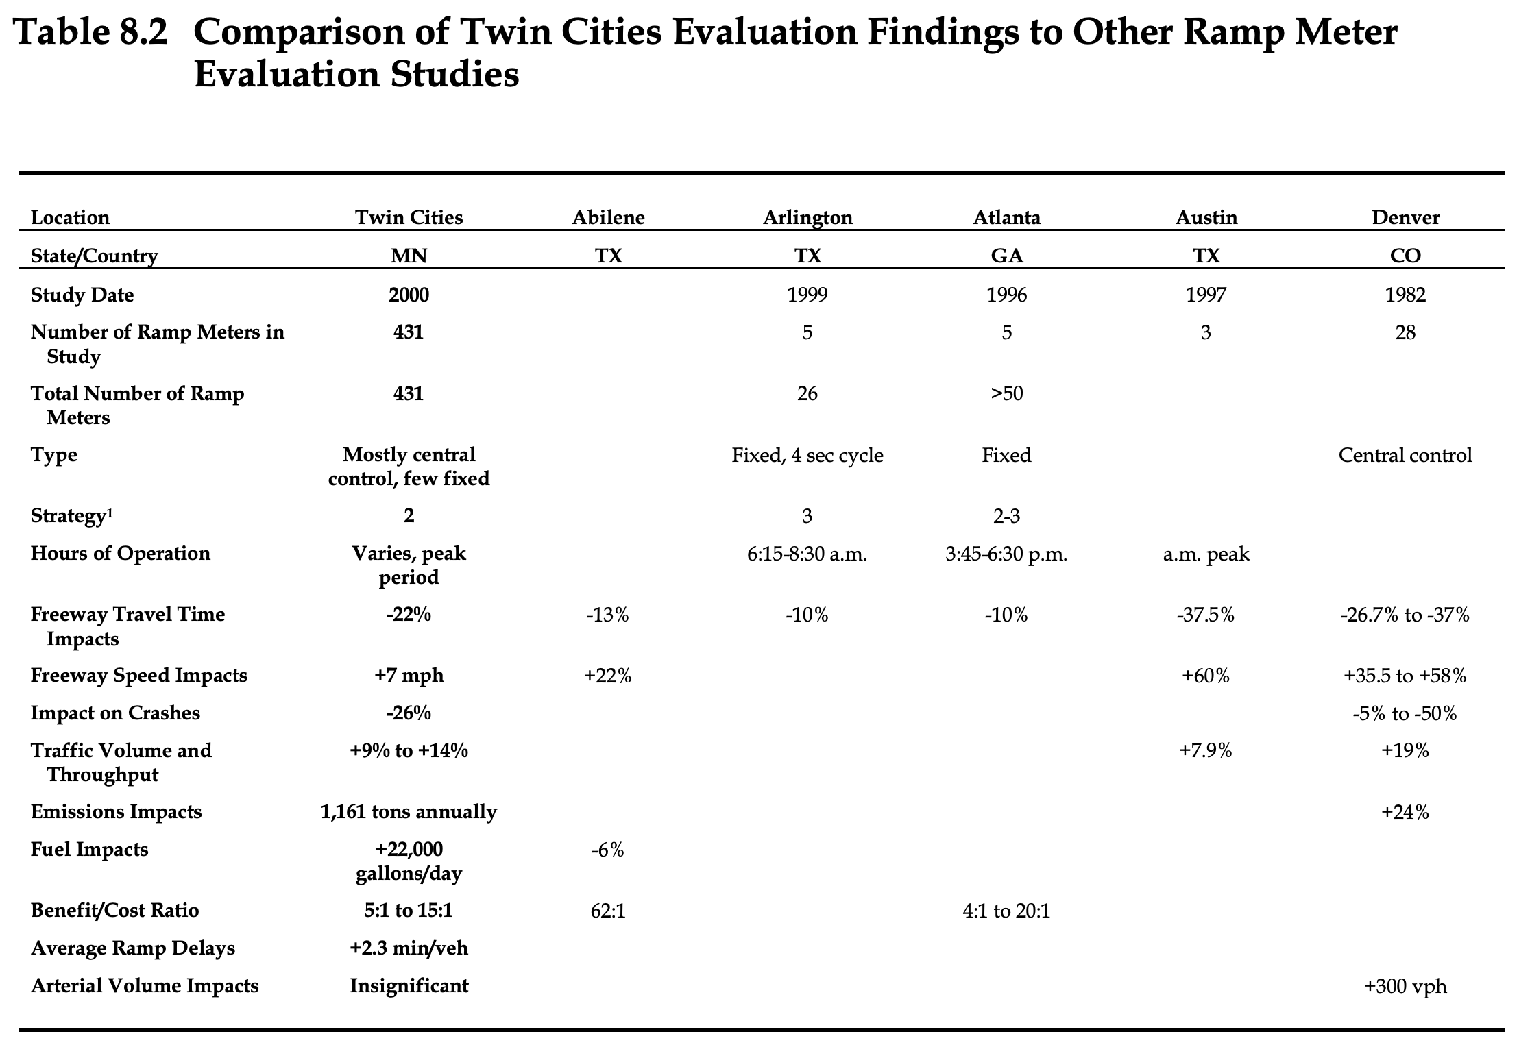
Benefit/cost ratio of ramp meters
http://www.dot.state.mn.us/rampmeter/pdf/finalreport.pdf

Slide 19
Shuttle Implementation
⏰
Notes:
Employees enroll on a company platform, giving the company access to their address/preferred pickup location
Optimization of pickup points and times

